Slide 1
SDTM Training
By Radhakrishnan Raghuraman

Slide 2
Course Content
Overview of Clinical Trial Process
Documents to be submitted to the FDA for Approval - Reason for SDTM/ADAM/TFL
SDTM Fundamentals and how to read SDTM and SDTMIG
Sources for and Nature of Clinical Trial Raw Data with example
Important Concepts: Data formatting v/s(non) imputation in SDTM, order of creation of domains, importance of traceability etc.
Trial Design Theory and Trial Design Domains
General Purpose Domains
Interventions Domains
Events Domains
Findings Domains

Slide 3
Course Content (Contd.)
7. Special Purpose Domains
8. Representing Relationships including use of RELREC and SUPP domains
9. Creation of a new Custom domain
10. Order of variables, Core Designations, Convention for missing values, Multiple Values for a Variable
11. Handling Free Text from a CRF
12. Conformance and Compliance using Pinnacle 21

Slide 4
Section 1. Overview Of Clinical Trial Process

Slide 5
Topics
What Are Clinical Trials
Who Conducts and Participates in Clinical Trials
Phases of Clinical Trials
Participant’s Journey in Clinical Trials
Important Concepts in Clinical Trials
Regulatory Agencies in Clinical Trials
Other Important Terminologies
Protocol, SAP, CRF and eCRF sample
Comparison of SDTM and CDASH

Slide 6
Introduction to Clinical Trials
What are Clinical Trials?
Clinical trials are research investigations in which people volunteer to participate in new treatments, interventions to determine the safety and efficacy of the new drug or device or procedure.
Clinical trials may compare a new medical approach to a standard one that is already available, to a placebo that contains no active ingredients, or to no intervention.
Photo by National Cancer Institute on Unsplash

Slide 7
Stages of Clinical Trials
1. Pre-clinical studies are the experiments that are conducted in the laboratory and with animals long before a new drug is ever introduced for use by humans. If these studies are promising, the drug maker usually pursues an Investigational New Drug (IND) application. The IND application allows the drug maker to conduct clinical trials of the new compound on human subjects.
2. Phase 1 trials are the “first in man” studies of a new drug in humans. These studies are usually carried out on small samples of subjects. The idea here is to determine the safety of the drug in a small and usually healthy volunteer study population. These studies are oftentimes very fast moving projects, because they are quick to enroll patients and the results are needed rapidly. This can be challenging for the statistical programmer, and there is little time to spare when the time frame of a phase 1 study can be weeks or months at most.
3. Phase 2 trials go beyond phase 1 studies in that they begin to explore and define the efficacy of a drug. Phase 2 studies have larger (100– 200 patients) study populations than phase 1 studies and are aimed at narrowing the dose range for the new medication. Safety is monitored at this stage as well, and phase 2 trials are generally conducted in the target study population. Phase 2 studies can often take a bit longer to complete because the trial timeline may be longer, with more assessments, and with more patients than phase 1 trials.
4. Phase 3 trials are large-scale clinical trials on populations that number in the hundreds to thousands of patients. These are the critical trials that the drug maker runs to show that its new drug is both safe and efficacious in the target study population. If the phase 3 trials are successful, they will form the keystone elements of a New Drug Application (NDA). This type of clinical trial can run for many months or many years.
5. Phase 4 trials, or post-marketing trials, are usually conducted to monitor the long-term safety of a new drug after the drug is already available to consumers. Phase 4 trials can run for years, and they tend to have a lessened sense of urgency than you would see from the earlier phase trials.

Slide 8
Phases of Clinical Trials
Phase | Objective | # Volunteers | Duration | Success rate(approx)
I | Evaluates Safety Determine Safe Dosage Identify Side Effects on healthy volunteers | 20-100 | Several Months | 70%
II | Test effectiveness Further Safety Evaluation | 100-1000 | Several Months to 2 Years | 33%
III | Confirm Effectiveness Monitor Side Effects Risk assessment Collect data for analysis | 300-3000 or more | Average 3-4 years | 25-30%
IV | Compare with other treatments monitor a drug's long-term effectiveness determine the cost-effectiveness | Large patient population post marketing | Mandatory 2 years minimum | NA.Can result in a drug or device being taken off the market or restrictions of use

Slide 9
Participants journey in Clinical Trial
Pre-Screening
Appointment set for Screening visit
Screening Visits - Informed Consent signed
Check for Inclusion/ Exclusion Criteria
Criteria met. Subject Enrolled
Subject Randomized
Regular Visits as per the protocol design
Visits-> test done, samples collected, data collected.
Study completion

Slide 10
Important Concepts in Clinical Trials
Randomization of study therapy. When you randomly assign patients to study therapy, you reduce potential treatment bias.
Treatment Blinding Blinding a patient to treatment means that the patient does not know what treatment is being administered.
In a single-blind trial, only the patient does not know which treatment is being administered.
In a double-blind trial, neither the patient nor the patient’s doctor or the staff administering treatment knows which treatment is being given.
On occasion there may even be a triple-blind trial, where the patient, the patient’s doctor, and the staff analyzing the trial data do not know which therapy is being given.
Unblinded or Open Label trials are trials where the patient, doctor, the patient’s doctor and the staff analyzing the trial data do know which therapy is being given.
A clinical trial can be carried out at a single site or it can be a multi-center trial. In a single-site trial, all of the patients are seen at
the same clinical site, and, in a multi-center trial, several clinical sites are used. Multi-center trials are needed to eliminate site
specific bias or because there are more patients required than a single site can enroll.
Trials may be designed to determine superiority, equivalence, or non-inferiority between therapies. A superiority trial is intended
to show that one therapy is significantly better than another. An equivalence trial is designed to show that there is no clinically
significant difference between therapies. A non-inferiority trial is designed to show that one therapy is not inferior to another
Therapy.

Slide 11
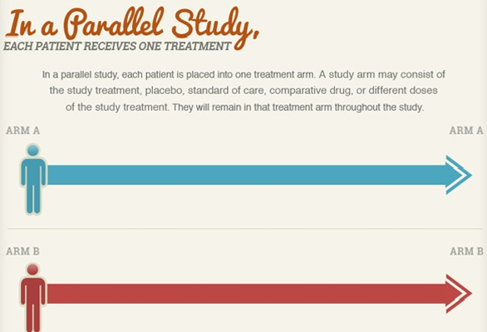
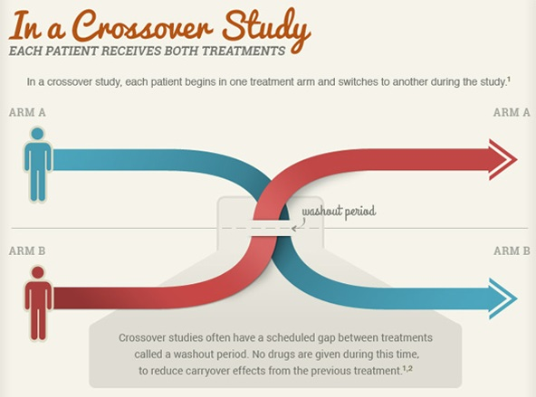
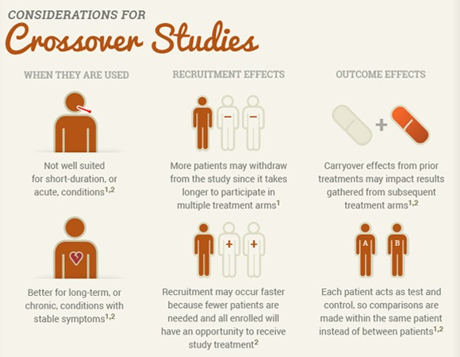
Parallel and Crossover Studies

Slide 12
Regulatory and Standards Organizations
Industry Regulations and Standards Regulatory authorities govern and direct much of the work of the statistical programmer in the pharmaceutical industry. It is important for you to know about the following regulations, guidance, and standards organizations.
International Conference on Harmonization (ICH) The International Conference on Harmonization (ICH) is a non-profit group that works with the pharmaceutical regulatory authorities in the United States, Europe, and Japan to develop common regulatory guidance for all three. The goal of the ICH is to define a common set of regulations so that a pharmaceutical regulatory application in one country can also be used in another. Over time, the Food and Drug Administration (FDA) usually adopts the guidelines developed by the ICH, so you can watch the development of guidance at the ICH to see what FDA requirements may be forthcoming.
The Clinical Data Interchange Standards Consortium (CDISC) is a non-profit group that defines clinical data standards for the pharmaceutical industry. CDISC has developed numerous data models that you should familiarize yourself with.
Food and Drug Administration (FDA) Regulation and Guidance The FDA is the department within the United States Department of Health and Human Services that is charged with ensuring the safety and effectiveness of drugs, biologics, and devices marketed in the United States as well as food, cosmetics, and tobacco. Any work that you perform that contributes to a submission to the FDA is covered by these federal regulations. There are a number of specific regulations and guidance that you should know.

Slide 13
Regulatory and Standards Organizations
21 CFR – Part 11 means that you must be qualified to do your work, your programming must be validated, you must have system security in place, and you must have change control procedures for your SAS programming. Additional FDA guidance on 21 CFR – Part 11 can be found in the FDA publication titled “Guidance for Industry Part 11, Electronic Records; Electronic Signatures– Scope and Application.”
Other Documents Include:
“ICH E3 Structure and Content of Clinical Study Reports”
“ICH E9 Statistical Principles for Clinical Trials”
“ICH E6 Good Clinical Practice: Consolidated Guidance”

Slide 14
Other Important terminologies contd...
Define-XML. Previously known as the “Case Report Tabulation Data Definition Specification,” Define-XML is the replacement model for the old data definition file (define.pdf) sent to the FDA with electronic submissions. Define-XML is based on the CDISC Operational Data Model (ODM) and is intended to provide a machine-readable version of define.pdf via define.xml. Because define.xml is a machine-readable file, the metadata about the submission data sets can easily be read by computer applications. This enables the FDA to work more easily with the data submitted to it. It may also enable you to do your work more efficiently and effectively if you are able to leverage your metadata.
Protocol: The protocol describes the device or medication to be used, the patient populations under study, the statistical plan of the clinical trial, and the details of the disease state. If you want to understand the disease state or indication further, you may want to seek out a clinical investigator of the clinical trial or do some further reading about the disease.
The SAP (statistical analysis plan) is a very detailed document, separate from the protocol, that describes how the clinical trial data will be analyzed. The SAP presents the entire statistical analysis in considerable detail. The SAP describes which inferential analyses will be done, defines the study population, presents data windowing or other special data handling rules, and often includes draft output shells that show precisely which tables, listings, and graphs will be provided in the reporting.

Slide 15
Other Important terminologies contd...
Case Report Form (CRF): A case report form (or CRF) is a paper or electronic questionnaire specifically used in clinical trial research.^{[1]} The case report form is the tool used by the sponsor of the clinical trial to collect data from each participating patient. All data on each patient participating in a clinical trial are held and/or documented in the CRF, including adverse events.
The sponsor of the clinical trial develops the CRF to collect the specific data they need in order to test their hypotheses or answer their research questions. The size of a CRF can range from a handwritten one-time 'snapshot' of a patient's physical condition to hundreds of pages of electronically captured data obtained over a period of weeks or months. (It can also include required check-up visits months after the patient's treatment has stopped.)
The sponsor is responsible for designing a CRF that accurately represents the protocol of the clinical trial, as well as managing its production, monitoring the data collection and auditing the content of the filled-in CRFs.
Case report forms contain data obtained during the patient's participation in the clinical trial. Before being sent to the sponsor, this data is usually de-identified (not traceable to the patient) by removing the patient's name, medical record number, etc., and giving the patient a unique study number. The supervising Institutional Review Board (IRB) oversees the release of any personally identifiable data to the sponsor. Though paper CRFs are still used largely, use of electronic CRFs (eCRFS) are gaining popularity due to the advantages they offer such as improved data quality, online discrepancy management and faster database lock etc.

Slide 16
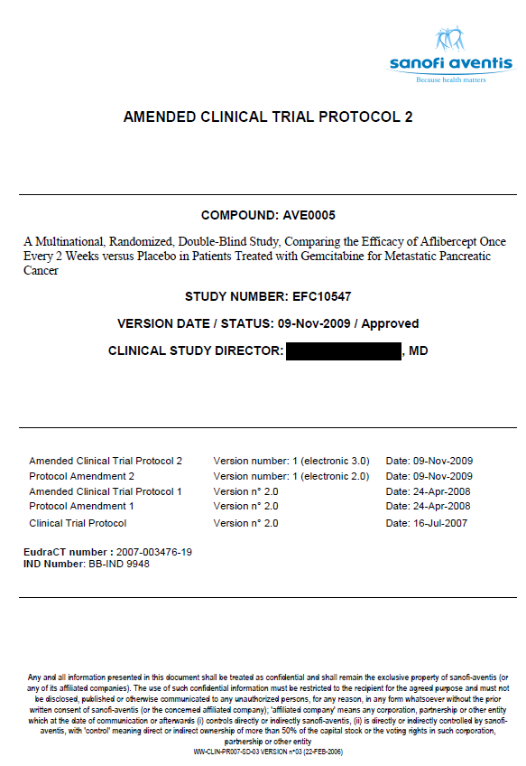
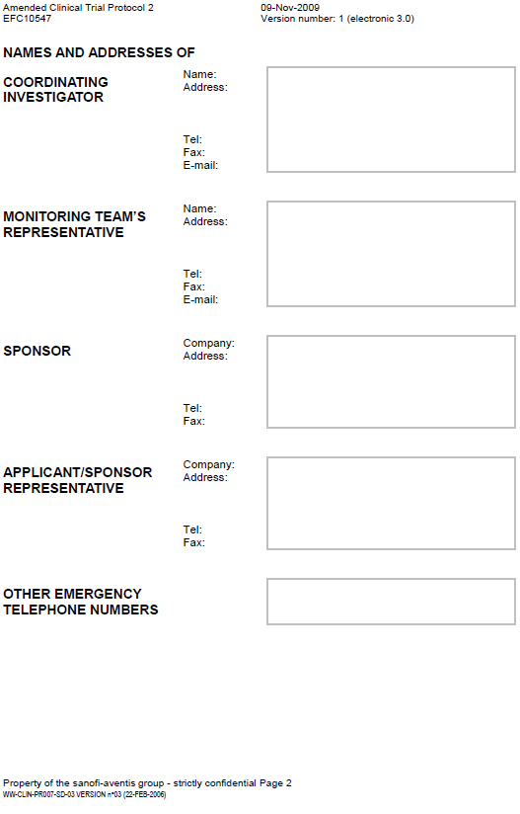
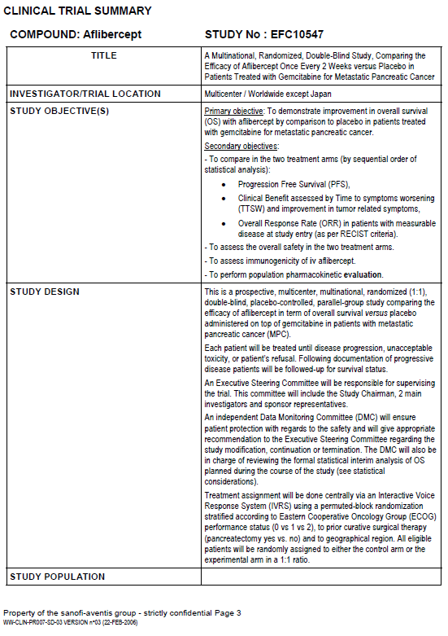
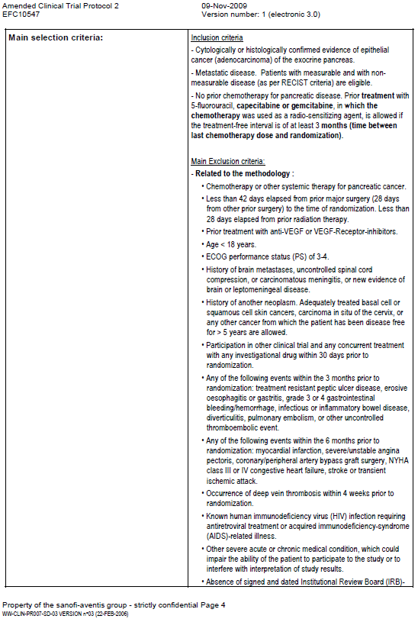
Protocol Sample

Slide 17
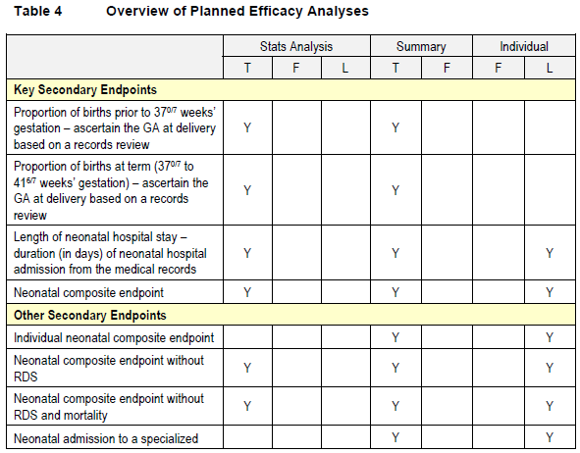
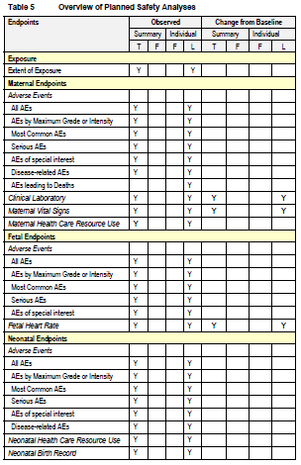
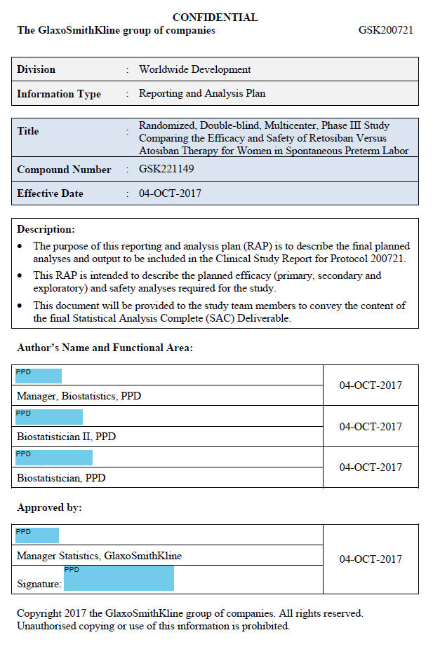
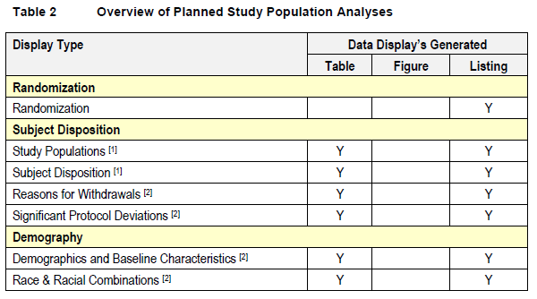
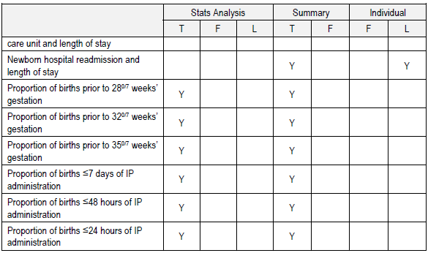
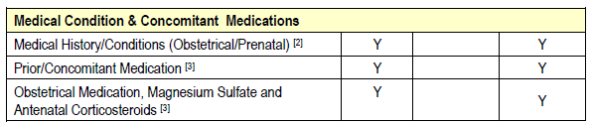
SAP Sample

Slide 18
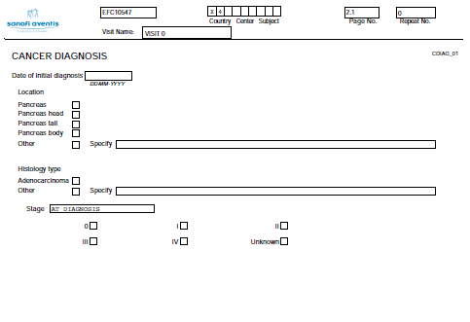
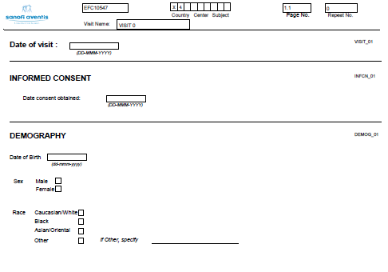
Case Report Form
Sample Case report form :

Slide 19
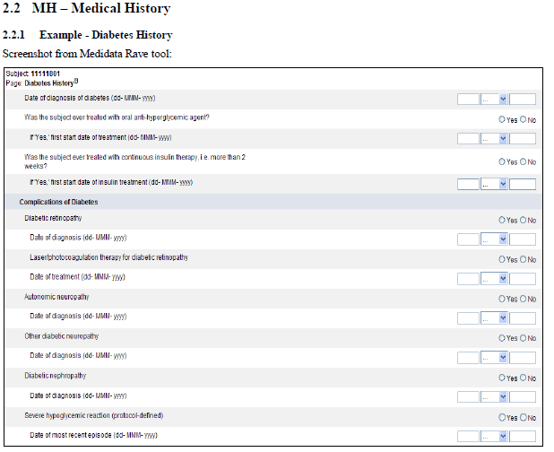
Electronic Case Report Form
eCRF (electronic case report form):An auditable electronic record of information that is reported to the sponsor or EDC provider on each trial subject to enable data pertaining to a clinical investigation protocol to be systematically captured, reviewed, managed, stored, analyzed, and reported. The eCRF is a CRF in which related data items and their associated comments, notes, and signatures are linked programmatically

Slide 20
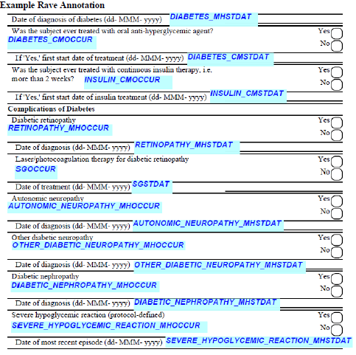
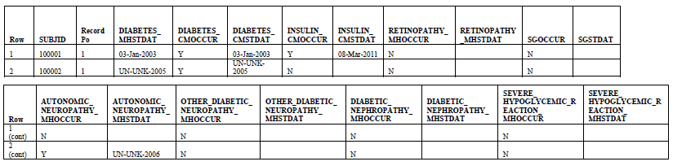
CDASH and Sample Annotated Rave eCRF Form

Slide 21
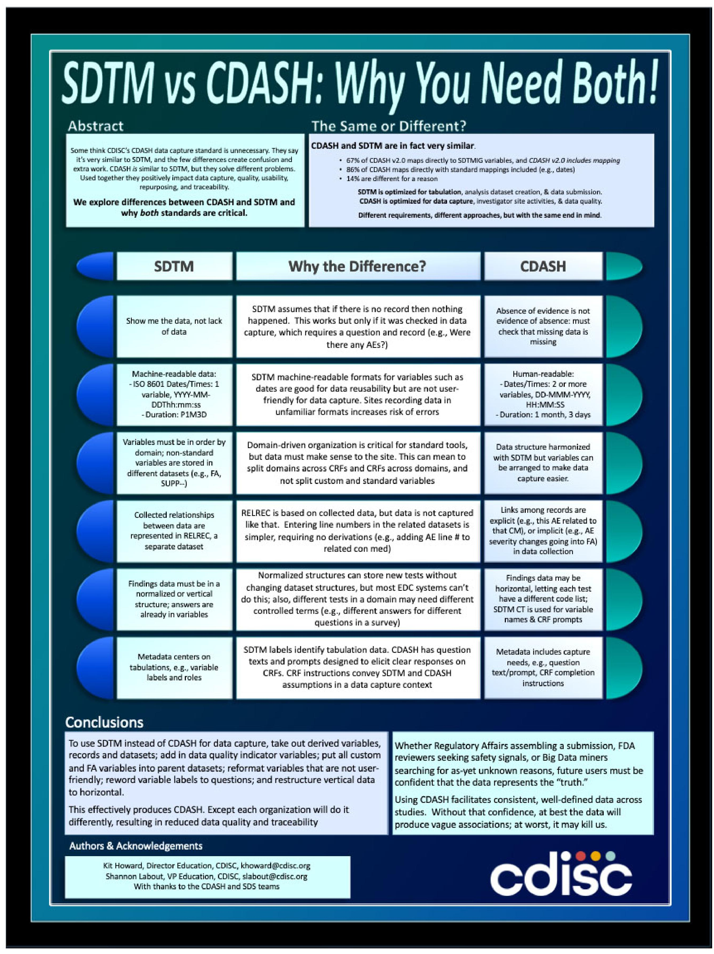

Slide 22
References
https://clinicaltrials.gov
Shostak, Jack. SAS Programming in the Pharmaceutical Industry, Second Edition (p. 5). SAS Institute. Kindle Edition.
https://www.projectdatasphere.org/

Slide 23
Section 2 - Documents to be submitted to the FDA for Approval - Reason for SDTM/ADAM/TFL

Slide 24
Topics
Documents Describing Standards of Submission to FDA
Standards of Submission to FDA
Terminology Standards
Folder Structure and Description of Study Datasets
What is SDTM, ADAM and TFL
Sample SDTM and ADAM Table
Mock and Sample Tables, Listings and Figures
Reason for SDTM, ADAM and TFL?

Slide 25
Documents Describing Standards for Submission to FDA
The Electronic Common Technical Document (eCTD) is the vision for future electronic submissions to the FDA. This specification was developed by the International Conference on Harmonization (ICH) as an open-standards solution for electronic submissions to worldwide regulatory authorities. The FDA has adopted the eCTD as the standard for how to submit electronic submissions to the FDA. Note that the eCTD still depends largely on submitting text documents as PDF files and submitting data sets as SAS XPORT transport format files.
This eCTD Technical Conformance Guide (Guide) provides specifications, recommendations, and general considerations on how to submit electronic Common Technical Document (eCTD)-based electronic submissions to the Center for Drug Evaluation and Research (CDER) or the Center for Biologics Evaluation and Research (CBER).

Slide 26
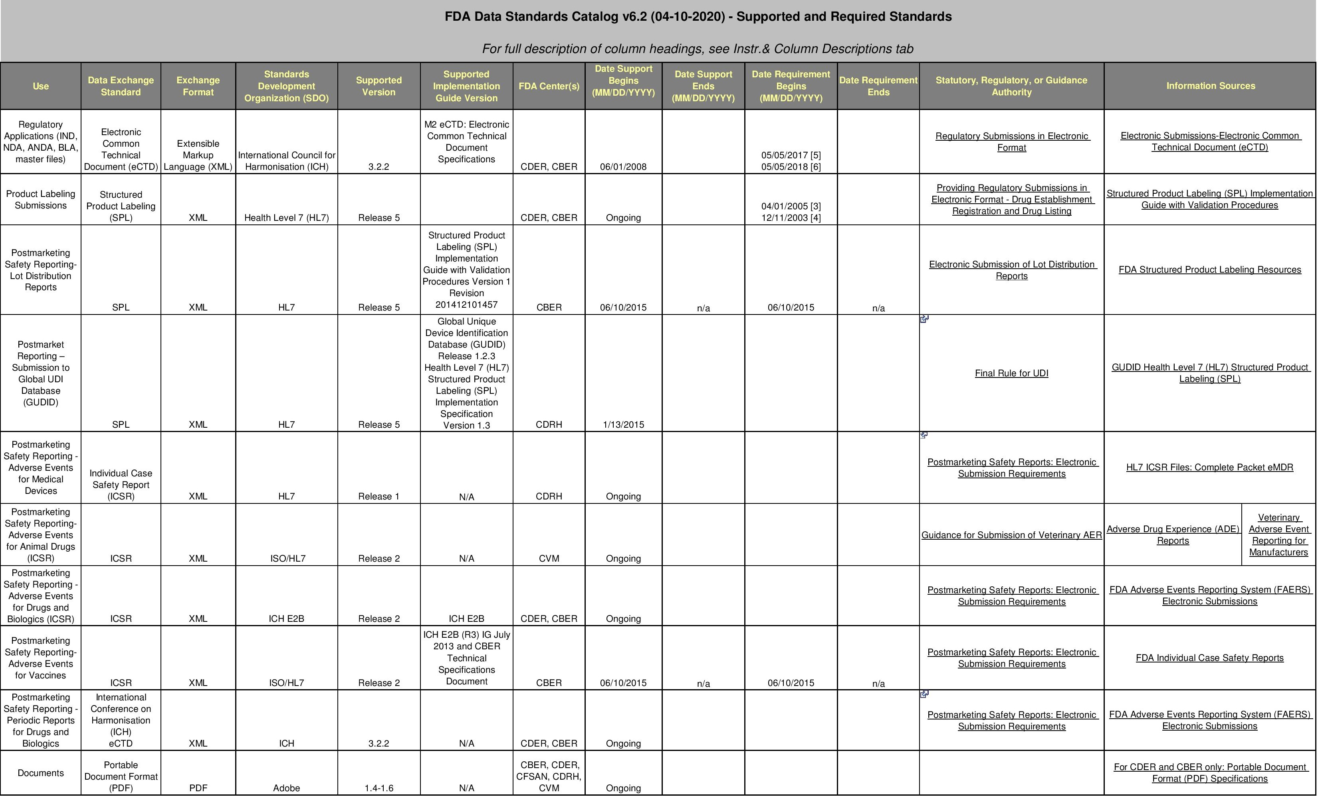
Standards for Submission to FDA – Exchange Standards 1

Slide 27
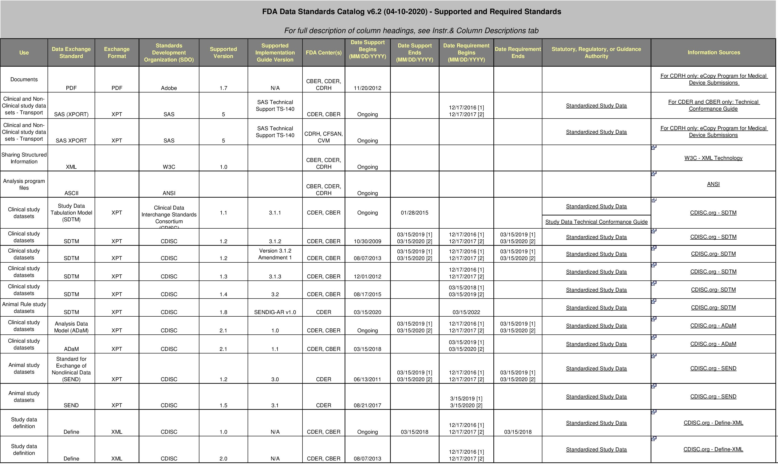
Standards for Submission to FDA–Exchange Standards 2

Slide 28
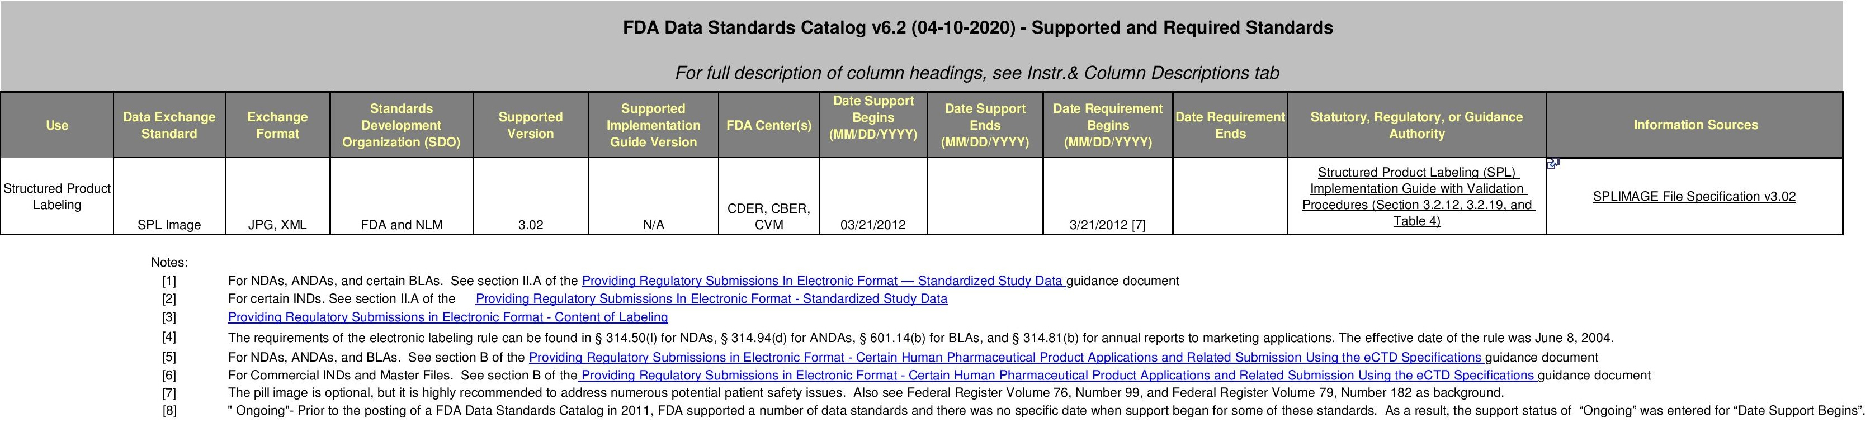
Standards for Submission to FDA–Exchange Standards 3

Slide 29
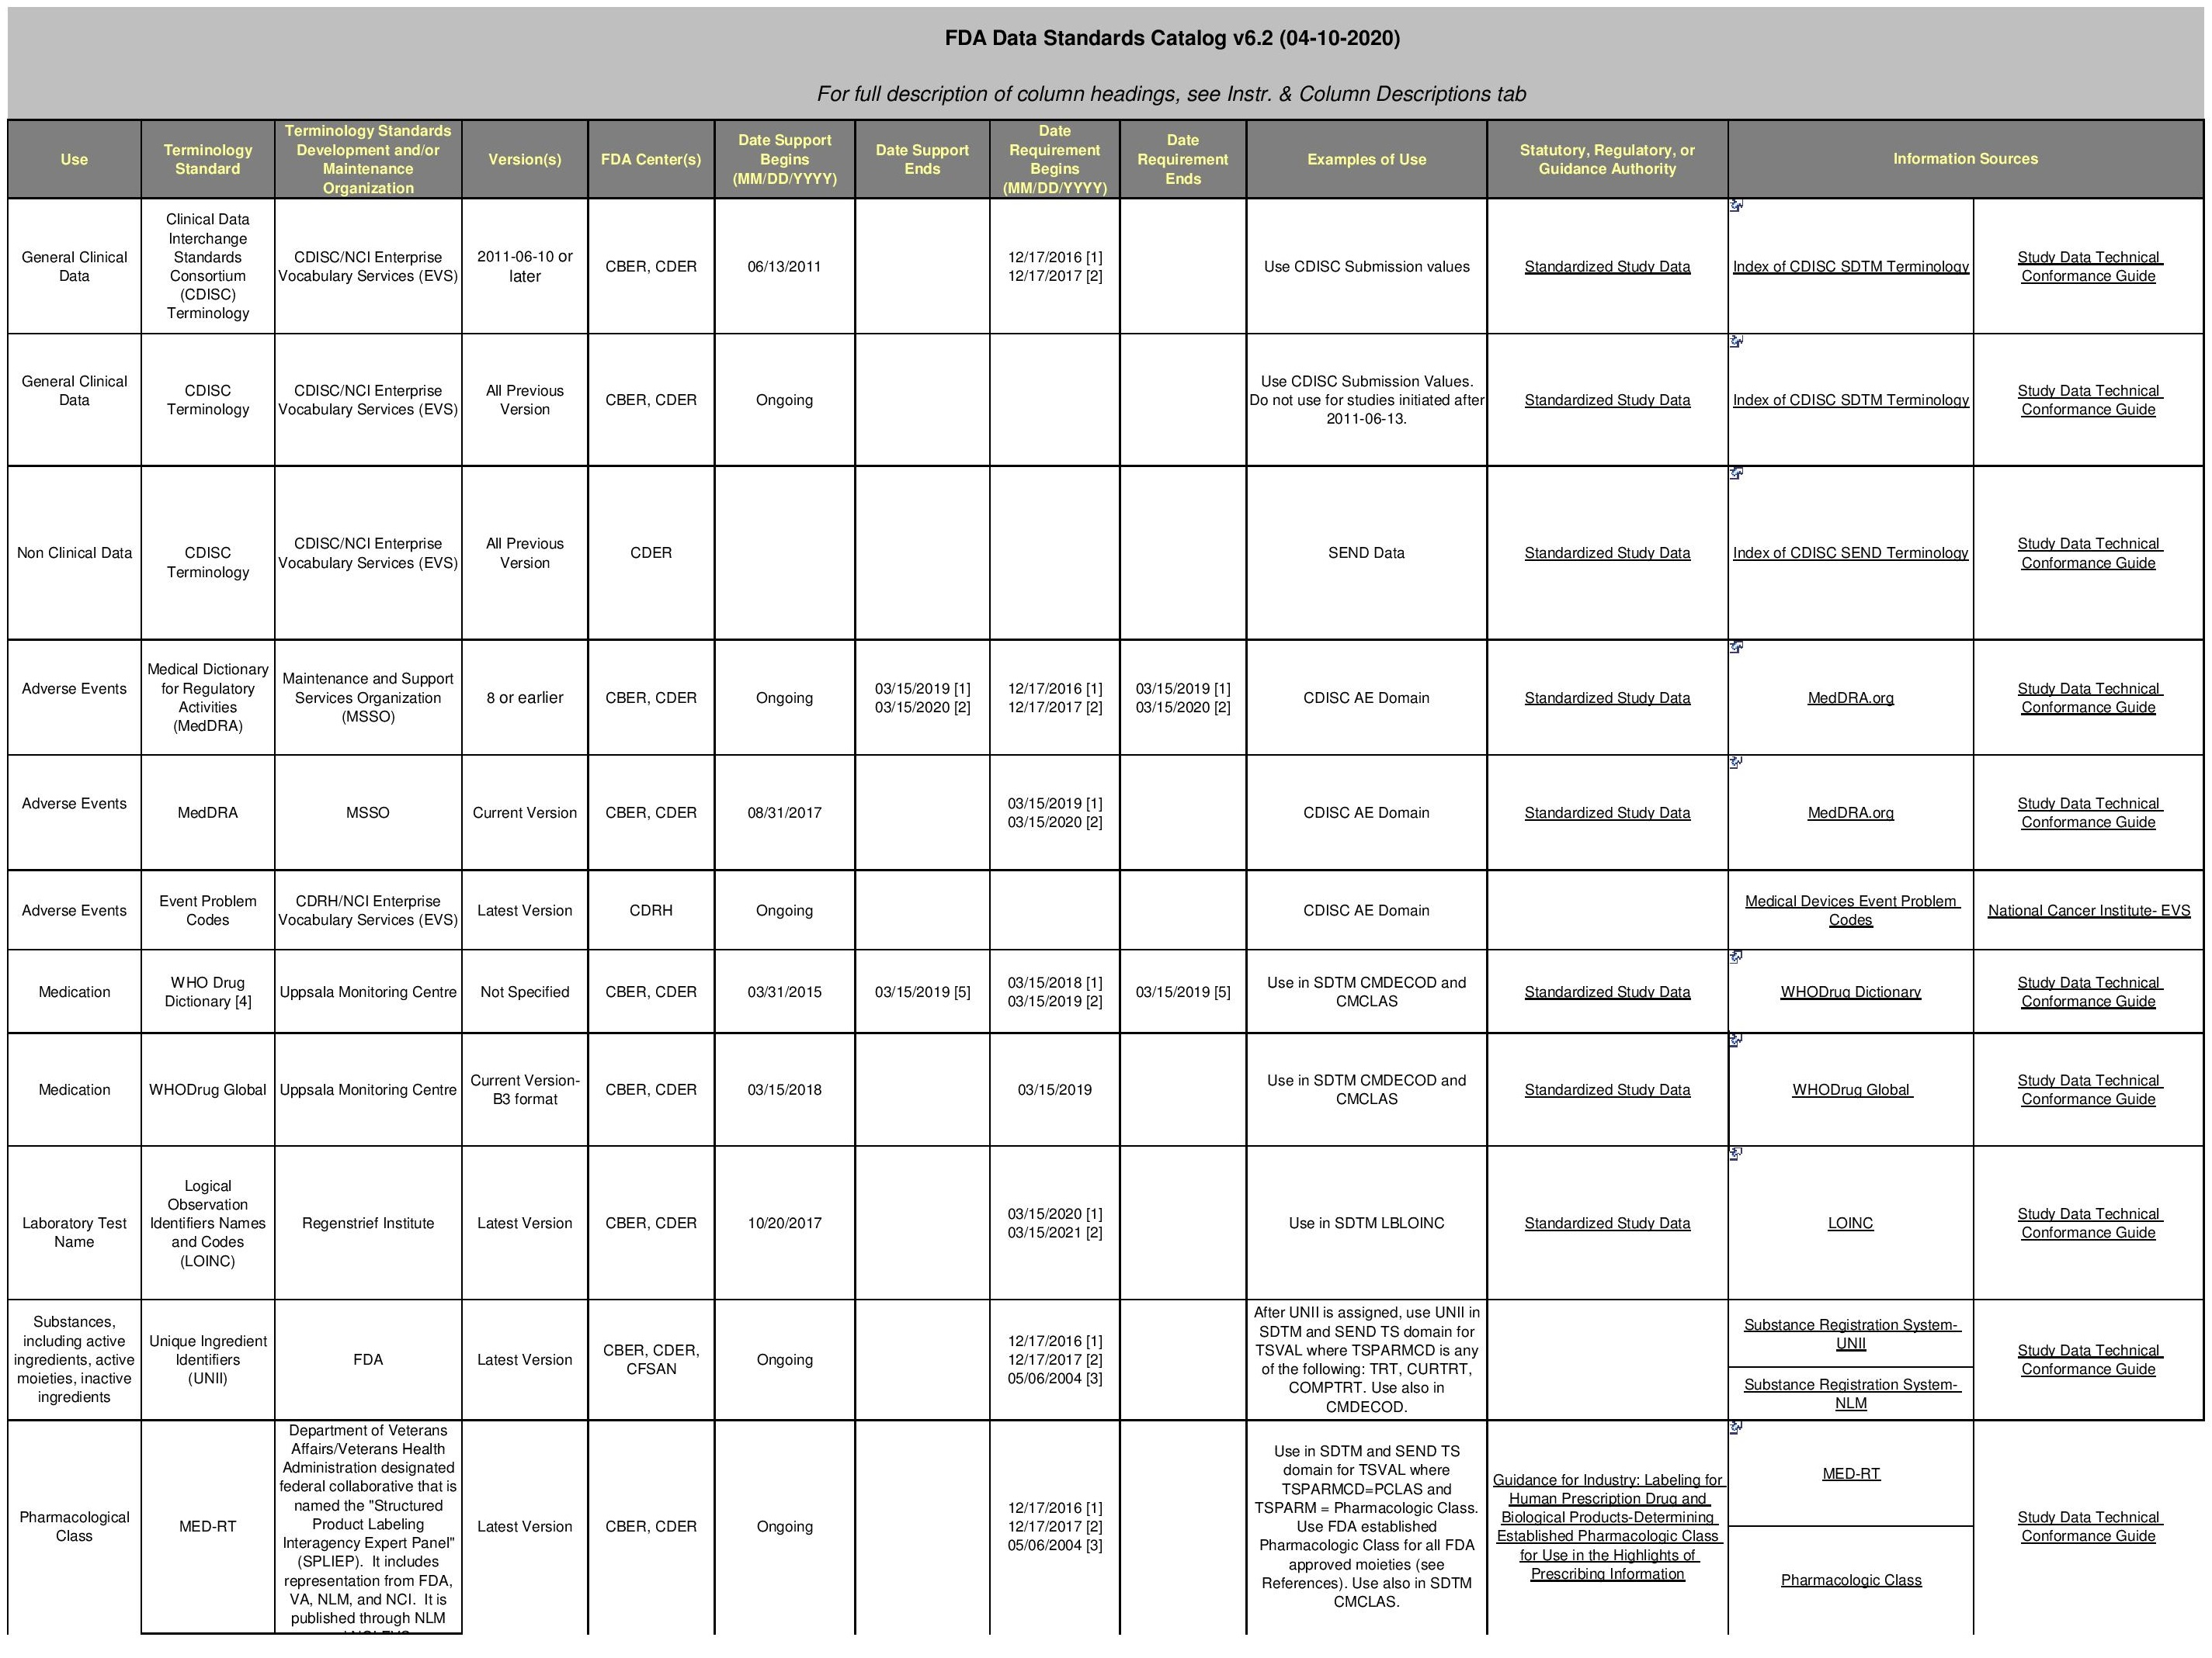
Standards for Submission to FDA–Terminology Standards 1

Slide 30
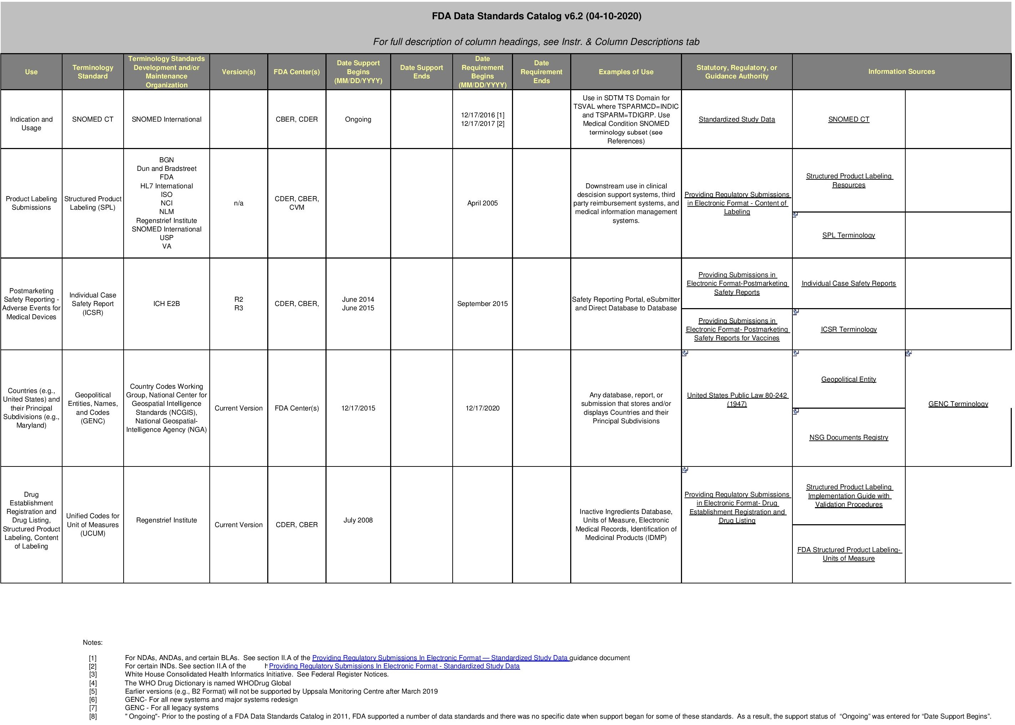
Standards for Submission to FDA–Terminology Standards 2

Slide 31
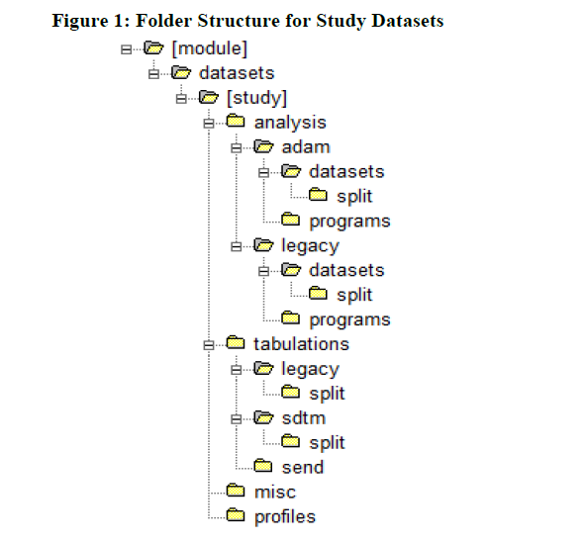
Folder Structure for Study Datasets

Slide 32
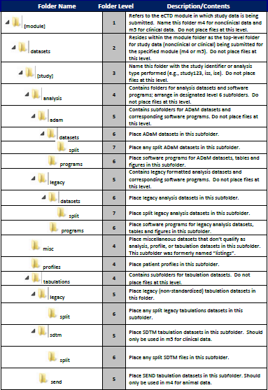
Study Structure and File Folder Dataset Description

Slide 33
What is SDTM, ADaM and TLF(Tables, Listings, Figures)?
Study Data Tabulation Model (SDTM). The SDTM defines the data tabulation data sets that are to be sent to the FDA as part of a regulatory submission. The FDA has endorsed the SDTM in its Electronic Common Technical Document (eCTD) guidance and the Study Data Specifications document. The SDTM was originally designed to simplify the production of case report tabulations (CRTs). Therefore, the SDTM is designed to be listing friendly, but not necessarily friendly for creating statistical summaries and analysis.
Analysis Data Model (ADaM). The CDISC ADaM team defines data set definition guidance for the analysis data structures. These data sets are designed for creating statistical summaries and analysis. ADaM datasets contain all derived variables required for the analysis process. This means that ADaM datasets should aim to be analysis ready or “one proc away” for the statistical outputs.
Tables, listings and figures (TLF) are generated as part of the normal reporting process. The trial data is analyzed and presented as tables and figures in clinical trial reports. The tables, listings and figures are also used to answer regulatory questions and to support publications based on the trial data. Generally, tables contain statistics about the data, while listings present the data in their raw form simply listed for review. These tables and listings can number in the hundreds for a new drug application or just a dozen or so for an independent data monitoring committee (IDMC) report.

Slide 34
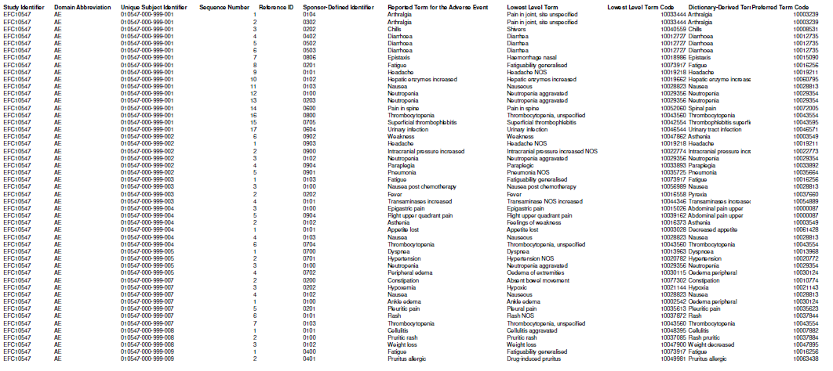
Sample SDTM Table – AE Domain

Slide 35
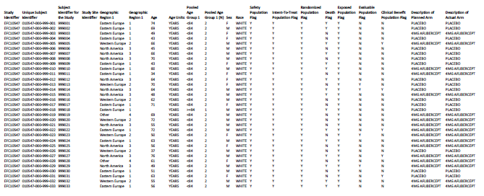
Sample ADAM Table - ADSL

Slide 36
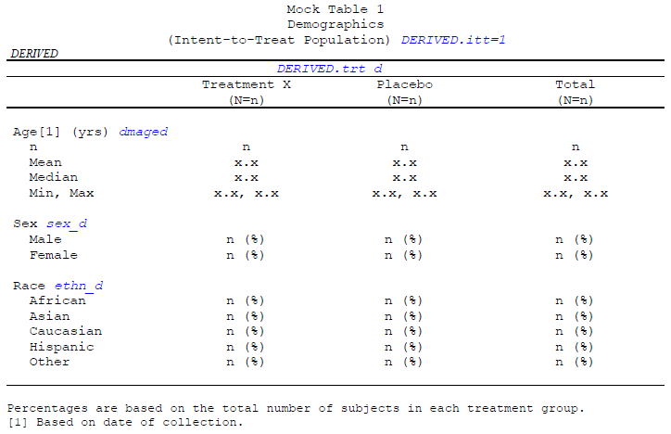
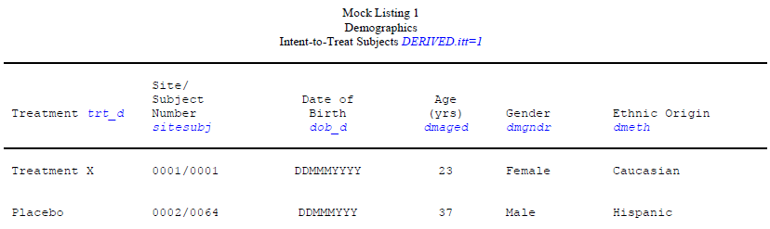
Mock Annotated Table and Listing
Mock Annotated Table
Mock Annotated Listing

Slide 37
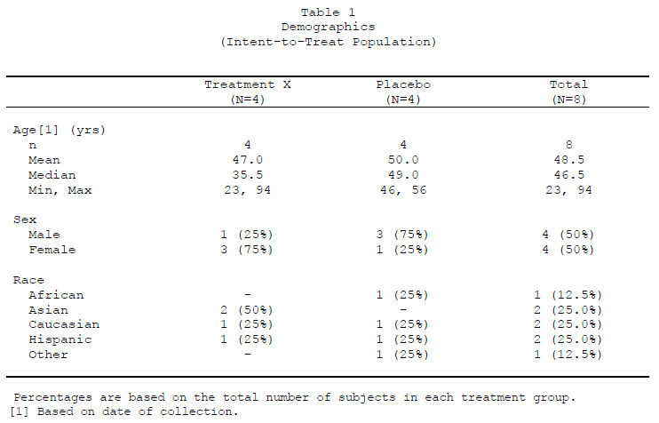
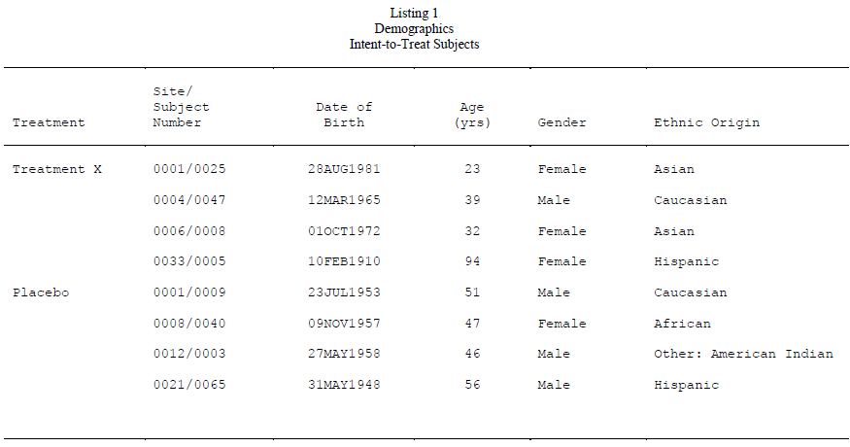
Sample Output Table and Listing
Sample Output Table after Programming
Sample Output Listing after Programming

Slide 38
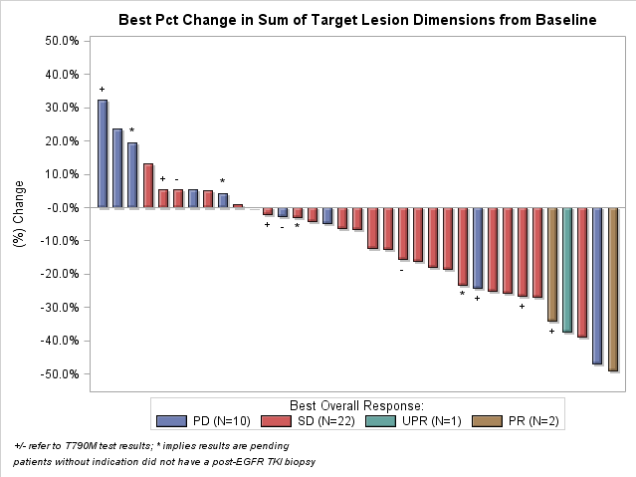
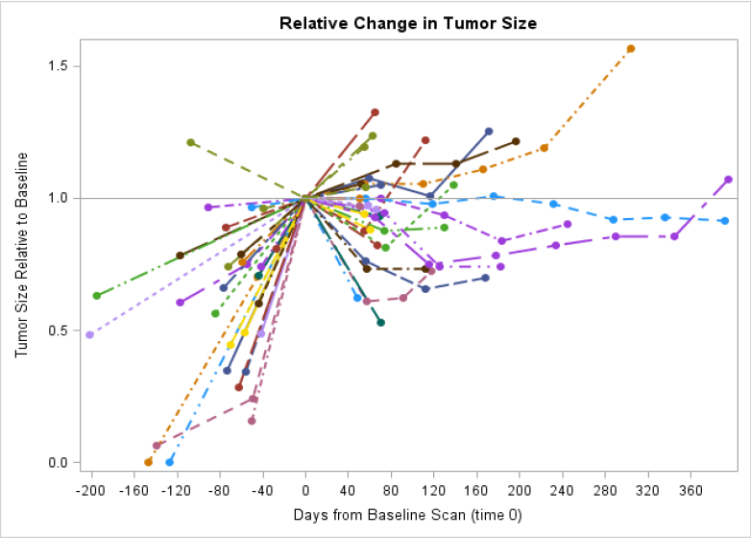
Figures Sample 1 - Oncology
Waterfall Plot with Data Labels
Spider Plot displaying Change in Tumor Size, Starting in Pre-Treatment Phase

Slide 39
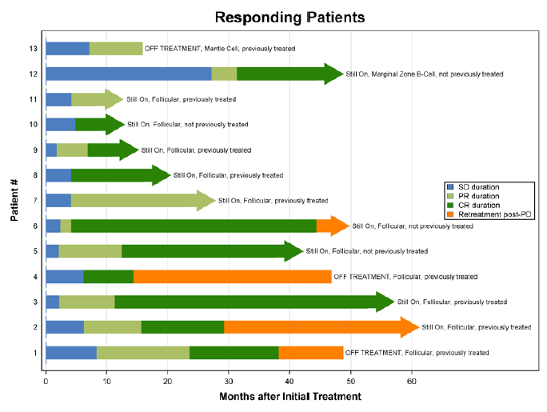
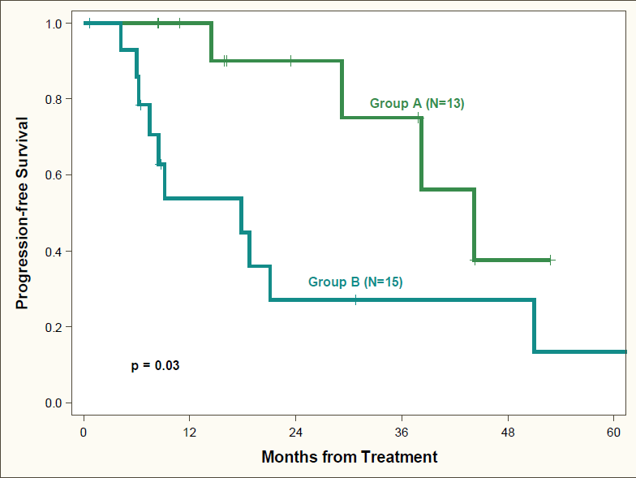
Figures Sample 2 - Oncology
Timeline Plot of Response and Treatment Durations
Survival Plot with Text Annotation and Custom Colours

Slide 40
Reasons For SDTM???
Creation of Standardized Tools to help with Review
To Enable future Statistical Analysis on Multiple Studies
Analysis Datasets are to be Created from SDTM Domains
FDA may not accept Study Data submitted in other formats
Etc.

Slide 41
Section 3 – Fundamentals Of SDTM

Slide 42
Topics
Fundamentals of SDTM
Observations and Variables
Types of Domain Variables
Types of Domain Datasets (General and Non General)
Method Of Reading the Domain Specifications
Versions of SDTM and SDTMIG and Current Version
SDTM Standard Domain Model
When to Create a New Domain
Dataset Metadata
Advantages of Leveraging Metadata to Create Domains

Slide 43
Fundamentals of SDTM
There are 3 primary documents used to guide the creation of SDTM from raw data:
The SDTM Implementation Guide (SDTMIG) is intended to guide the organization, structure, and format of standard clinical trial tabulation datasets.
The current version of SDTM which defines a standard structure for Study Data Tabulations, Current Version is V1.8
Therapeutic Area User Guides (TAUG) extend the Foundational Standards to represent data that pertains to specific disease areas. TA Standards include disease-specific metadata, examples and guidance on implementing CDISC standards for a variety of uses, including global regulatory submission.
What are Domains and Datasets?
A data set is a collection of data. In the case of tabular data, a data set corresponds to one or more database tables, where every column of a table represents a particular variable, and each row corresponds to a given record of the data set in question.

Slide 44
Observations about study subjects are normally collected for all subjects in a series of domains. A domain is defined as a collection of logically related observations with a common topic. The logic of the relationship may pertain to the scientific subject matter of the data or to its role in the trial. Each domain is represented by a single dataset.
Each domain dataset is distinguished by a unique, two-character code that should be used consistently throughout the submission. This code, which is stored in the SDTM variable named DOMAIN, is used in four ways: as the dataset name, the value of the DOMAIN variable in that dataset; as a prefix for most variable names in that dataset; and as a value in the RDOMAIN variable in relationship tables.
All datasets are structured as flat files with rows representing observations and columns representing variables. Each dataset is described by metadata definitions that provide information about the variables used in the dataset. The metadata are described in a data definition document, a Define-XML document, that is submitted with the data to regulatory authorities.
Data stored in SDTM datasets include both raw (as originally collected) and derived values (e.g., converted into standard units, or computed on the basis of multiple values, such as an average). The SDTM lists only the name, label, and type, with a set of brief CDISC guidelines that provide a general description for each variable.

Slide 45
Observations and Variables
The SDTM is built around the concept of observations collected about subjects who participated in a clinical study. Each observation can be described by a series of variables, corresponding to a row in a dataset. Each variable can be classified according to its Role. A Role determines the type of information conveyed by the variable about each distinct observation and how it can be used. Variables can be classified into five major roles:
Role | Description
Identifier Variables | Variables used to identify the records like Study Identifier(STUDYID), Subject Identifier (USUBJID), Sequence Identifier(--SEQ)
Topic Variables | Variables that specifies the focus of the Observation like Lab Test Name (LBTEST), Adverse Event Term (AETERM), Reported Drug Name(CMTRT)
Timing Variables | Variables that save the timings of the Observation like AE STart Time (AESTDTC), AE End Time(AEENDTC)
Qualifier Variables | Variables that store the values that describe the results( illustrative text or numeric values) like Lab Test Results (LBORRES) or traits of the Observation (such as units or descriptive adjectives) like AE Severity (AESEV)
Rule variables | Variables that express the algorithm or executable method in the Trial Design model

Slide 46
Types of Domain Datasets – General Observation Classes
General Observation class
Most subject-level observations collected during the study should be represented according to one of the three SDTM general observation classes:
The Interventions class captures investigational, therapeutic, and other treatments that are administered to the subject (with some actual or expected physiological effect) either as specified by the study protocol (e.g., exposure to study drug), coincident with the study assessment period (e.g., concomitant medications), or self-administered by the subject (such as use of alcohol, tobacco, or caffeine).
The Events class captures planned protocol milestones such as randomization and study completion, and occurrences, conditions, or incidents independent of planned study evaluations occurring during the trial (e.g., adverse events) or prior to the trial (e.g., medical history).
The Findings class captures the observations resulting from planned evaluations to address specific tests or questions such as laboratory tests, ECG testing, and questions listed on questionnaires.
The majority of data, which typically consists of measurements or responses to questions, usually at specific visits or time points, will fit the Findings general observation class

Slide 47
Types of Domain Datasets – Not General observation Class
Domain datasets, which include subject-level data that do not conform to one of the three general observation classes. These include Demographics (DM), Comments (CO), Subject Elements (SE), and Subject Visits (SV) , and are described in Section for Special Purpose Domains.
Trial Design Model (TDM) datasets, which represent information about the study design but do not contain subject data. These include datasets such as Trial Arms (TA) and Trial Elements (TE) and are described in Section for Trial Design Model Datasets.
Relationship datasets, such as the RELREC and SUPP-- datasets. These are described in Section 8, Representing Relationships and Data.
Study Reference datasets, which include Device Identifiers (DI), Non-host Organism Identifiers (OI), and Pharmacogenomic/Genetic Biomarker Identifiers (PB). These provide structures for representing study specific terminology used in subject data. These are described in Section for Study References.

Slide 48
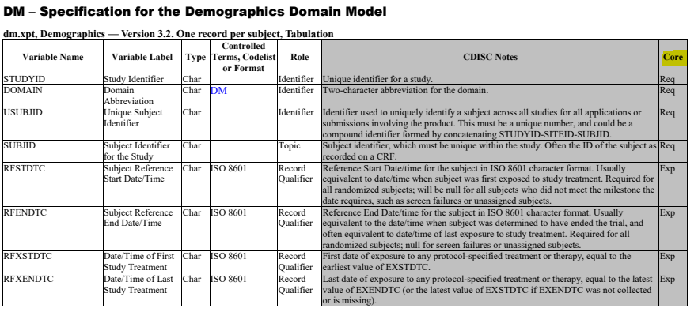
Method To Read a Domain Specification
Type: One of the two SAS datatypes, "Num" or "Char". These values are taken directly from the SDTM.
CDISC Notes: The notes may include any of the following:
A description of what the variable means.
Information about how this variable relates to another variable. Rules for when or how the variable should be populated, or how the contents should be formatted.
Examples of values that might appear in the variable. Such examples are only examples, and although they may be CDISC controlled terminology values, their presence in a CDISC note should not be construed as definitive.
Controlled Terms, Codelist, or Format
Controlled Terms are represented as hyperlinked text. The domain code in the row for the DOMAIN variable is the most common kind of controlled term represented in domain specifications.
Codelist An asterisk * indicates that the variable may be subject to controlled terminology.
Variable Label: A longer name for the variable. If a sponsor includes in a dataset an allowable variable not in the domain specification, they will create an appropriate label.
For variables that do include the domain prefix, this name from the SDTM, but with "--" placeholder in the SDTM variable name replaced by the domain prefix.
Contains one of the three values "Req", "Exp", or "Perm",
References : SDTMIGv3.2

Slide 49
Core, Codelist and Controlled Terminology Details
Core variable is used both as a measure of compliance, and to provide general guidance to sponsors.
Variables are divided into 3 core categories:
Required - Basic to the identification of the record. Cannot be Null for any record.
Expected - Establishes the Observation Context. Must always be included the dataset though it could be null for few records
Permissible - Must be included if collected or derived. Else could be Null or not present in the Dataset itself.
Codelist is a list of valid codes and decoded values for a variable. The purpose of a codelist is to ensure that data values comply with controlled terminology.
Controlled Terminology is the set of codelists and valid values used with data items required for submission to FDA and PMDA in CDISC-compliant datasets.
Additional Timing variables can be added as needed to a standard domain model based on the three general observation classes, except for the cases specified in Assumption 4.4.8, Date and Time Reported in a Domain Based on Findings. Timing variables can be added to special purpose domains only where specified in the SDTMIG domain model assumptions. Timing variables cannot be added to SUPPQUAL datasets or to RELREC

Slide 50
Version Of SDTM and SDTMIG
Current Version is SDTMIG 3.3 and SDTM version 1.8. Try to use the current version.
The SDTM has been designed with backward compatibility. Datasets prepared with previous versions should be compatible with current version.
Later versions usually add variables and/or domains and correct textual errors but do not eliminate variables(deprecated only in some cases) or change structures incorporated in previous versions. Metadata and some domains indicate the version of SDTM being used.

Slide 51
SDTM Standard Domain Model and Domains
A sponsor should only submit domain datasets that were actually collected (or directly derived from the collected data) for a given study. Decisions on what data to collect should be based on the scientific objectives of the study, rather than the SDTM. Note that any data collected that will be submitted in an analysis dataset must also appear in a tabulation dataset.
The collected data for a given study may use standard domains from this and other SDTM Implementation Guides as well as additional custom domains based on the three general observation classes.
What constitutes a change for the purposes of deciding a domain version will be developed further, but for SDTMIG v3.3, a domain was assigned a version of v3.3 if there was a change to the specification and/or the assumptions from the domain as it appeared in SDTMIG v3.2.
These general rules apply when determining which variables to include in a domain:
The Identifier variables, STUDYID, USUBJID, DOMAIN, and --SEQ are required in all domains based on the general observation classes. Other Identifiers may be added as needed.
Any Timing variables are permissible for use in any submission dataset based on a general observation class except where restricted by specific domain assumptions. Any additional Qualifier variables from the same general observation class may be added to a domain model except where restricted by specific domain assumptions.
Sponsors may not add any variables other than those described in the preceding three bullets. The addition of non-standard variables will compromise the FDA's ability to populate the data repository and to use standard tools. The SDTM allows for the inclusion of a sponsor's non-SDTM variables using the Supplemental Qualifiers special purpose dataset structure, described in Section 8.4, Relating Non-Standard Variables Values to a Parent Domain. As the SDTM continues to evolve over time, certain additional standard variables may be added to the general observation classes.
.

Slide 52
Standard variables must not be renamed or modified for novel usage. Their metadata should not be changed.
A Permissible variable should be used in an SDTM dataset wherever appropriate.
If a study includes a data item that would be represented in a Permissible variable, then that variable must be included in the SDTM dataset, even if null. Indicate no data were available for that variable in the Define-XML document.
If a study did not include a data item that would be represented in a Permissible variable, then that variable should not be included in the SDTM dataset and should not be declared in the Define-XML document

Slide 53
Dataset Metadata
The SDTMIG provides standard descriptions of some of the most commonly used data domains, with metadata attributes. These include descriptive metadata attributes that should be included in a Define-XML document.
The models for General Observation Class illustrate the selection of a subset of the variables offered in one of the general observation classes, along with applicable timing variables. The models also show how a standard variable from a general observation class should be adjusted to meet the specific content needs of a particular domain, including making the label more meaningful, specifying controlled terminology, and creating domain-specific notes and examples.

Slide 54
Metadata for Regulatory Submissions
There are 8 main levels of Metadata:
Dataset-Level Metadata
CDISC Submission Value-Level Metadata
Variable Level Metadata
Value Level Metadata
Computational Method Metadata
Where Clause Metadata
Comments Metadata
External Links
The Define-XML document that accompanies a submission should also describe each dataset that is included in the submission and describe the natural key structure of each dataset.
Dataset definition metadata should include the dataset filenames, descriptions, locations, structures, class, purpose, and keys. In addition, comments can also be provided where needed.
In the event that no records are present in a dataset. the empty dataset should not be submitted and should not be described in the Define-XML document.

Slide 55
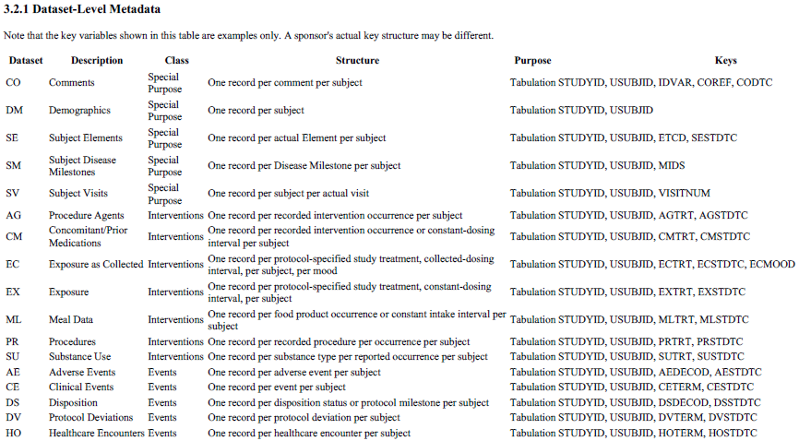
Dataset Level Metadata Sample

Slide 56
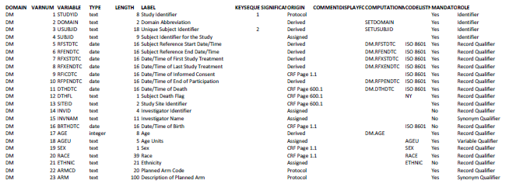
Variable Level Metadata

Slide 57
Value Level Metadata Need
One of the challenges of implementing SDTM and ADaM is the vertical data structure where some variables are dependent on test code (xxTESTCD) in SDTM or Parameter (PARAMCD) in ADaM. This type of metadata is described as “value level metadata” and at a basic level describes the metadata of one variable based on the value of another variable. For example, how do you describe the result of a Vital Sign (VSORRES) when the Vital Signs test code (VSTESTCD) is WEIGHT? This definition can be different for different values of the test code and is best described based on those values.
“Value Level Metadata should be provided when there is a need to describe differing metadata attributes for subsets of cells within a column.”
• “It is not required for Findings domains where the results have the same characteristics in all records, such as IE domains.”
• “In ADaM, value level metadata often describes AVAL or AVALC in BDS data structures based on values of PARAMCD.”
• “Value Level Metadata should be applied when it provides information useful for interpreting study data. It need not be applied in all cases.”
• “It is left to the discretion of the creator when it is useful to provide Value Level Metadata and when it is not.”

Slide 58
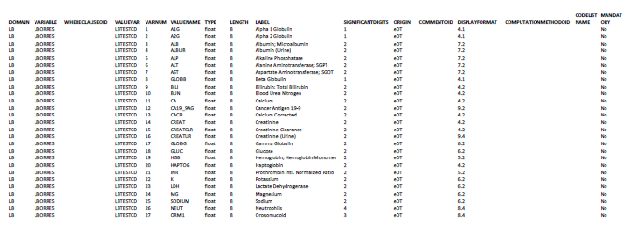
Valuelevel Metadata

Slide 59
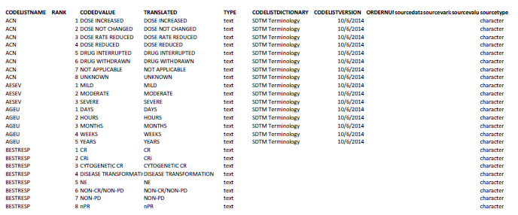
Codelist Metadata

Slide 60
Where Clause, Computational Metadata
Where clause metadata is new to Define-XML version 2.0. Although where clauses exist in the define.xml file for every value level metadata item, they only need to be specified in the metadata spreadsheet for records that cannot be uniquely identified by only one variable value.
Although the CDISC SDTM can be described as containing primarily the collected data for a clinical trial, you can store some derived information in the SDTM. Total scores for a questionnaire, derived laboratory values, and even the AGE variable in DM can be considered derived content that is appropriate to store in the SDTM. The define.xml file gives you a place to store this derivation, and as such we have metadata to hold that information.

Slide 61
Comments Metadata and External Links
Comments Metadata: Some metadata elements or groups can have a comment associated with it This is a change from version 1.0, which allowed specific comment attributes to each element. The change is a good one since it allows identical comments to be specified once, but referenced in multiple locations. The Comments metadata spreadsheet provides a common place to specify unique comments.
External Links: Typically, an SDTM define file has links to two documents: the annotated CRFs and a reviewer’s guide. These files, and additional supplemental documents if desired, should now be specified in the External Links spreadsheet.

Slide 62
Advantages of Leveraging Metadata to Create Domains
Using Base SAS alone:
data dm; set sourcedata.demographics;
length usubjid $ 24 race $ 30;
❶ label usubjid = “Unique Subject ID”
❷ race = “Race”; usubjid = put(subject,10.); if nrace = 1 then
❸ race = ‘WHITE’; else if nrace = 2 then race = ‘BLACK OR AFRICAN
AMERICAN’; else if nrace = 3 then race = ‘OTHER’; run;
❶ Variable lengths are buried in the SAS code, which makes them hard to change globally and difficult to make consistent across domains.

Slide 63
Leveraging Metadata to Create Domains – Contd….
2. Variable labels are buried in the SAS code, which makes them hard to change globally and difficult to make consistent across domains.
3. SDTM-controlled terminology is buried in the SAS code, making it hard to verify, maintain, and get into the define.xml file.
If you take this type of Base SAS approach to your SDTM conversion work, then you will run into the following problems because your SDTM metadata is buried in your SAS code:
Your SAS code will be hard to maintain.
Achieving variable attribute consistency across SDTM domains will be difficult. Lengths, labels, and variable types can vary for the same variable across domains

Slide 64
Leveraging Metadata to Create Domains – Contd….
You will have a very difficult time building a proper define.xml
file for your submission. At best, your define.xml file will be
based on the data that was observed and will omit possible
controlled terminology values that are not actually observed.
Using Metadata to create domains along with Macros solves all the above problems. The Structure and variables in SDTM change only rarely.
Note: Also, consider usage of SQL views in case of large datasets and to access the latest source data during joins. Use comments when describing complex comments or code. More comments are better!

Slide 65
Section 4 – Sources For And Nature Of Clinical Raw Data with Example

Slide 66
Electronic Data Capture (EDC)
An electronic data capture (EDC) system is a computerized system designed for the collection of clinical data in electronic format for use mainly in human clinical trials.^{[1]} EDC replaces the traditional paper-based data collection methodology to streamline data collection and expedite the time to market for drugs and medical devices. EDC solutions are widely adopted by pharmaceutical companies and contract research organizations (CRO).
Typically, EDC systems provide:
a graphical user interface component for data entry
a validation component to check user data
a reporting tool for analysis of the collected data
EDC systems are used by life sciences organizations, broadly defined as the pharmaceutical, medical device and biotechnology industries in all aspects of clinical research,^{[2]} but are particularly beneficial for late-phase (phase III-IV) studies and pharmacovigilance and post-market safety surveillance.
EDC can increase data accuracy and decrease the time to collect data for studies of drugs and medical devices.^{[3]} The trade-off that many drug developers encounter with deploying an EDC system to support their drug development is that there is a relatively high start-up process, followed by significant benefits over the duration of the trial. As a result, for an EDC to be economical the saving over the life of the trial must be greater than the set-up costs. This is often aggravated by two conditions:
.

Slide 67
Electronic Data Capture
1. The initial design of the study in EDC does not facilitate the decrease in costs over the life of the study due to poor planning or inexperience with EDC deployment; and
2. The initial set-up costs are higher than anticipated due to initial design of the study in EDC due to poor planning or experience with EDC deployment.
The net effect is to increase both the cost and risk to the study with insignificant benefits. However, with the maturation of today's EDC solutions, much of the earlier burdens for study design and set-up have been alleviated through technologies that allow for point-and-click, and drag-and-drop design modules. With little to no programming required, and reusability from global libraries and standardized forms such as CDISC's CDASH, deploying EDC can now rival the paper processes in terms of study start-up time.^{[4]} As a result, even the earlier phase studies have begun to adopt EDC technology
Some of the common motivations for using EDC include:
Cleaner Data – EDC software is particularly good at enforcing certain aspects of data quality. Edit checks programmed into the software can make sure data meets certain required formats, ranges, etc. before the data is accepted into the trial database.
.

Slide 68
Electronic Data Capture – Contd….
More Efficient Processes – EDC software can help guide the site through the series of study events, requesting only the data needed for the particular patient’s circumstance at a particular time. It faculties the process of clarifying data discrepancies with tools for identifying and resolving data issues with sites, and can help reduce the number of in-person site visits required during a trial.
Faster Access to Data – Web-based EDC systems can provide near real-time access to data in a clinical trial. This insight enables faster decision making, and can support adaptive trial designs
Open API’s are available for a variety of data sources such as ePRO (Electronic Patient-Reported Outcomes), lab data, medical imaging, randomization etc… to integrate with EDC

Slide 69
Laboratory Data
Lab data is Managed and Integrated with EDC in several ways:
In addition to information collected directly at the study site, most protocols include laboratory tests and other assessments that are conducted by centralized or external organizations. As the number of locations and stakeholders involved in collecting and consolidating protocol data increase, so does the likelihood of error.
Laboratory data has unique handling considerations compared to other types of external data. For each data point, laboratory normal ranges are provided and must match the demographics of the participant for the laboratory that completed the testing, on the date the testing was completed. Including normal ranges means there are usually four data points for each laboratory test completed: result, unit, low normal, and high normal.

Slide 70
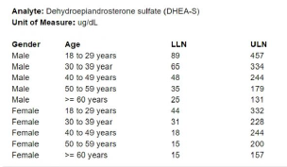
Laboratory Data Contd….
In addition, you may need to capture clinical significance for out of range tests.
There are several methods of handling laboratory data for a protocol. Each method brings opportunities and obstacles to each stakeholder, depending on the traits of the protocol and differences in site operations.
1. Maintain Lab Data Electronically and External to the EDC System
2. Upload Electronic Lab Results into the EDC System
3. Require Users to Enter Lab Results into the EDC
4. Full lab entry within the EDC

Slide 71
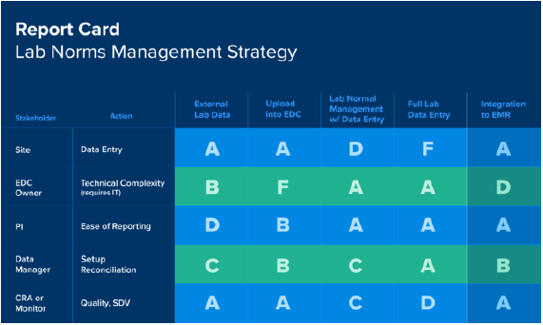
Laboratory Data Contd….

Slide 72
ETMF
An electronic master file or eTMF is a Trial Master File in electronic or digital format. It is a way of digitally capturing, managing, sharing and storing those essential documents and content from a clinical trial.
To understand further, let’s first describe what a Trial Master File or TMF is. Every organization, typically a pharmaceutical company or a biotech company, involved in a regulated clinical trial must comply with government regulatory requirements surrounding those clinical trials. One of the key criteria to fulfill regulatory compliance is to maintain and store certain essential documents related to that clinical trial. Essentially, a Trial Master File is a set of essential documents and content that shows how a clinical trial was conducted, managed and followed regulatory requirements.

Slide 73
ETMF
These essential documents allow for the evaluation of the conduct and quality of the clinical trial.
Wikipedia describes it further, “a trial master file contains essential documents for a clinical trial that may be subject to regulatory agency oversight. In order to comply with government regulatory requirements pertinent to clinical trials, every organization involved in clinical trials must maintain and store certain documents, images and content related to the clinical trial. Depending on the regulatory jurisdiction, this information may be stored in the trial master file or TMF.”

Slide 74
ETMF
Capturing and managing clinical trial documents through paper-based or network-folder TMFs can be time-consuming, difficult to manage, and may produce costly errors that put your clinical trials at risk. Adopting an eTMF allows for real-time oversight and management of documents to ensure compliance and audit readiness throughout the trial. Some key benefits include:
Access, approve, share and manage clinical documents anytime from a web-based application
Improved quality of the TMF: digital solutions make fewer errors than manual/paper processes
Improves efficiency during the conduct of a trial
Reduce regulatory risk: documents/reports can be audit ready far quicker than paper systems
Shorter trial start-up and close-out time
Faster document searching and retrieval
Cost savings from increased filing efficiency, reducing paper and labor usage

Slide 75
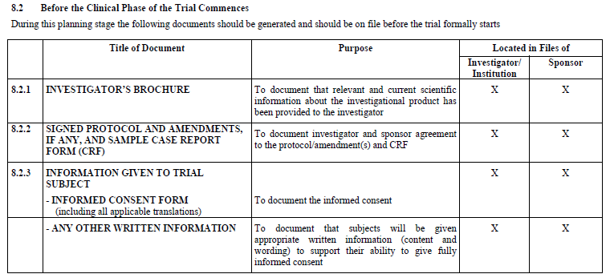
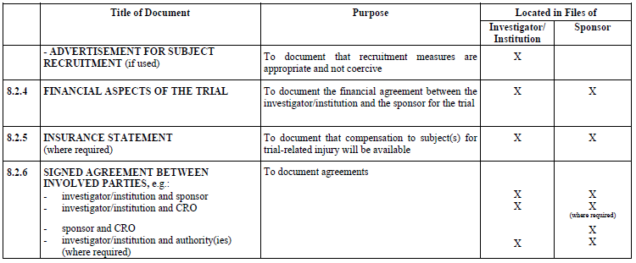
Documents present in ETMF before Trial as per ICH E6

Slide 76
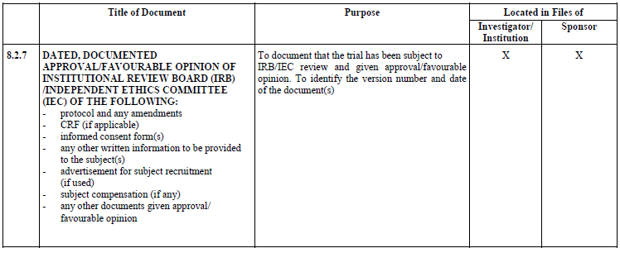
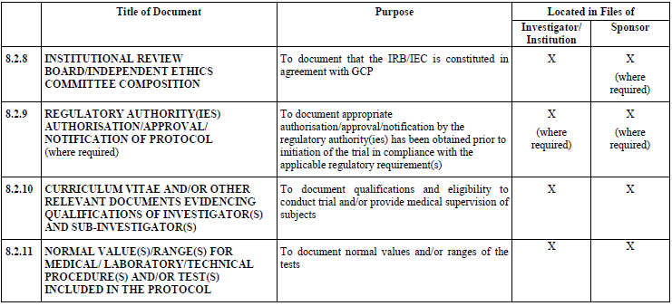
Documents present in ETMF before Trial as per ICH E6

Slide 77
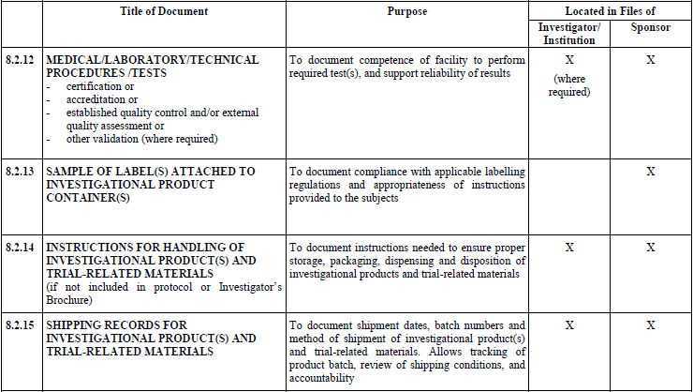
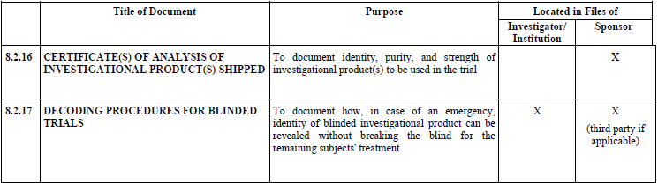
Documents present in ETMF before Trial as per ICH E6

Slide 78
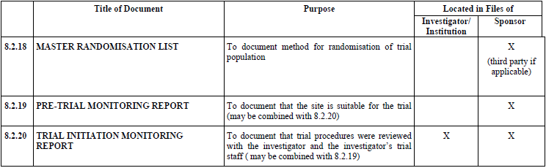
Documents present in ETMF before Trial as per ICH E6

Slide 79


Documents present in ETMF during Trial as per ICH E6

Slide 80

Documents present in ETMF during Trial as per ICH E6

Slide 81

Documents present in ETMF during Trial as per ICH E6

Slide 82


Documents present in ETMF during Trial as per ICH E6

Slide 83


Documents present in ETMF after Trial as per ICH E6

Slide 84
Clinical Trial Management System (CTMS)
A Clinical Trial Management System (CTMS) is a software system used by biotechnology and pharmaceutical industries to manage clinical trials in clinical research. The system maintains and manages planning, performing and reporting functions, along with participant contact information, tracking deadlines and milestones.
Clinical Trial Management System:
• Refers to the integration of planning, execution and management of clinical trials across the different organizations and partners involved in the process
• The major data points that are captured and integrated by CTMS include:
• Patient Data, Budgeting, Billing, Trial Protocol, and Regulatory Forms and Research
• Manage the functions and drive the convergence of
• Trial Management, Site Management, Investigator Management, and Clinical Supply Management
• Customizable Software System …to manage the large amount of data involved with the operation of clinical trials

Slide 85

Clinical Trial Management System (CTMS)
• Maintains and manages the planning, preparation, performance, and reporting …with emphasis on keeping upto-date contact information for participants and tracking deadlines and milestones…
• Provides data into a business intelligence system, which acts as a dashboard for trial managers

Slide 86

Clinical Trial Management System (CTMS)

Slide 87

Clinical Trial Management System (CTMS)

Slide 88

Clinical Trial Management System (CTMS)

Slide 89
Meddra and WhoDrug Dictionaries for Coding
Meddra the Medical Dictionary for Regulatory Activities, is a multilingual dictionary of standard terminology that is used to code medical events in humans, including patients’ medical histories and adverse events. The MedDRA dictionary is based on a five-tier hierarchical structure (Figure 1) that goes from system organ class (e.g. gastrointestinal disorders) down to lowest level terms (e.g. feeling queasy). This dictionary was originally based on a set of terminology used in the United Kingdom in the 1990s, and the ICH (the International Council for Harmonisation of Technical Requirements for Pharmaceuticals for Human Use) spearheaded the effort to bring this standard set of medical coding terms into use worldwide. MedDRA is maintained, distributed, and supported by the MSSO (MedDRA Maintenance and Support Services Organization) and the JMO (Japanese Maintenance Organization). MedDRA has undergone multiple revisions since it first began, and is updated every six months.
Current Meddra version is 22.1

Slide 90

Meddra and Whodrug Dictionaries for Coding

Slide 91
Meddra and Whodrug Dictionaries for Coding
What is WHODrug Global?
WHODrug Global is a drug reference dictionary that was first created in 1968, and uses
the Anatomical Therapeutic Chemical classification system to classify drugs. WHODrug
Global contains codes for a wide range of drugs, and is available in different scopes such
as WHODrug Enhanced and WHODrug Herbal, which enable coding of everything from
conventional medicines to herbal treatments. Using WHODrug Global portfolio coding
includes a variety of tools and resources that can be used to help protect patients by
clearly classifying their responses to different treatments, thereby improving analysis of
effectiveness and safety. This medical coding dictionary is maintained and supported by
the Uppsala Monitoring Center.

Slide 92
Meddra and Whodrug Dictionaries for Coding
In the Anatomical Therapeutic Chemical (ATC) classification system, the active substances are divided into different groups according to the organ or system on which they act and their therapeutic, pharmacological and chemical properties. Drugs are classified in groups at five different levels.
ATC 1st level
The system has fourteen main anatomical or pharmacological groups (1st level). The ATC 1st levels are shown in the figure.
ATC 2nd level
Pharmacological or Therapeutic subgroup
ATC 3rd& 4th levels
Chemical, Pharmacological or Therapeutic subgroup
ATC 5th level
Chemical substance
The 2nd, 3rd and 4th levels are often used to identify pharmacological subgroups when that is considered more appropriate than therapeutic or chemical subgroups.

Slide 93

Meddra and Whodrug Dictionaries for Coding

Slide 94

Meddra and Whodrug Dictionaries for Coding
Thus, in the ATC system all plain metformin preparations are given the code A10BA02. For the chemical substance, the International Nonproprietary Name (INN) is preferred. If INN names are not assigned, USAN (United States Adopted Name) or BAN (British Approved Name) names are usually chosen. The coding is important for obtaining accurate information in epidemiological studies. The five different levels allow comparisons to be made at various levels according to the purpose of the study.

Slide 95

Example of Clinical Raw data - Partial

Slide 96
Section 5 – Important Concepts: Data formatting v/s(non) imputation in SDTM, order of creation of domains, importance of traceability etc.

Slide 97
Data Formatting v/s Non-Imputation in SDTM
CDISC Terminology provides context, content, and meaning to clinical research data to improve access and use of CDISC standards.
In SDTM, raw data from the Data Management Team is formatted to meet SDTM standards.
While there is some derived data in terms of average, age etc…. Records for visits etc. cannot be imputed in case they are missing. This is only allowed in ADAM datasets.
Order Of Creation Of the Domains
Trial Design Domains, EC and EX, SV then SE, then the other Domains including DM

Slide 98
Importance of Traceability in SDTM
Traceability Need linkage: CRF -> SDTM -> ADaM -> CSR
SDTM datasets should be created from CRFs
If instead CRFs -> Raw -> SDTM, your analysis (and hopefully ADaM) datasets should be created from those same SDTM datasets, not the raw datasets
Features exist in the ADaM standard that allow for traceability of analyses to ADaM to SDTM.
Creating SDTM and Analysis data from the raw data is incorrect (especially when submitting only SDTM and analysis data Raw data should create SDTM, and SDTM should then create Analysis
Metadata in the form of proper define.xml described earlier also add to the traceability
Comment: FDA seems to expect sponsor to create Analysis dataset from SDTM not from Raw data

Slide 99
Section 6 – Trial Design Theory and Trial Design Domains

Slide 100
Topics
Concepts Definition
Example Trials
Trial Design Datasets - Experimental Design
Phases of Clinical Trials
Participant’s Journey in Clinical Trials
Important Concepts in Clinical Trials
Regulatory Agencies in Clinical Trials

Slide 101
Trial Design Domain - Concepts Definition
Trial Design: It is a plan for what will be done to subjects, and what data will be collected about them, in the course of the trial, to address the trial's objectives.
Epoch: The planned period of subjects' participation in the trial is divided into Epochs. Typically, the purpose of an Epoch will be to expose subjects to a treatment, or to prepare for such a treatment period or to gather data on subjects after a treatment has ended.
Arm: An Arm is a planned path through the trial. This path covers the entire time of the trial. The group of subjects assigned to a planned path is also called a treatment group. An Arm can be considered equivalent to a treatment group.
Element: An Element is a basic building block in the trial design. It involves administering a planned intervention , which may be treatment or no treatment, during a period of time.
Branch: In a trial with multiple Arms, the protocol plans for each subject to be assigned to one Arm. The time within the trial at which this assignment takes place is the point at which the Arm paths of the trial diverge, and so is called a branch point.
Treatments: The word "treatment" may be used in connection with Epochs, Study Cells, or Elements, but has different meanings in each context and include different levels of details.
Visit: It is the clinical encounter. Visit generally corresponds to subjects interacting with the investigator during Visits to the investigator's clinical site. However, there are trial Visit which may not correspond to a physical Visit.

Slide 102
How to Model the Design of a Clinical Trial
The following steps allow the modeler to move from more-familiar concepts, such as Arms, to less-familiar concepts, such as Elements and Epochs. The actual process of modeling a trial may depart from these numbered steps. Some steps will overlap, there may be several iterations, and not all steps are relevant for all studies.
1. Start from the flow chart or schema diagram usually included in the trial protocol. This diagram will show how many Arms the trial has, and the branch points, or decision points, where the Arms diverge.
2. Write down the decision rule for each branching point in the diagram. Does the assignment of a subject to an Arm depend on a randomization? On whether the subject responded to treatment? On some other criterion?
3. If the trial has multiple branching points, check whether all the branches that have been identified really lead to different Arms. The Arms will relate to the major comparisons the trial is designed to address. For some trials, there may be a group of somewhat different paths through the trial that are all considered to belong to a single Arm.
4. For each Arm, identify the major time periods of treatment and non-treatment a subject assigned to that Arm will go through. These are the Elements, or building blocks, of which the Arm is composed.
5. Define the starting point of each Element. Define the rule for how long the Element should last. Determine whether the Element is of fixed duration.
6. Re-examine the sequences of Elements that make up the various Arms and consider alternative Element definitions. Would it be better to “split” some Elements into smaller pieces or “lump” some Elements into larger pieces? Such decisions will depend on the aims of the trial and plans for analysis.
7. Compare the various Arms. In most clinical trials, especially blinded trials, the pattern of Elements will be similar for all Arms, and it will make sense to define Trial Epochs. Assign names to these Epochs. During the conduct of a blinded trial, it will not be known which Arm a subject has been assigned to, or which treatment Elements they are experiencing, but the Epochs they are passing through will be known.
8. Identify the Visits planned for the trial. Define the planned start timings for each Visit, expressed relative to the ordered sequences of Elements that make up the Arms. Define the rules for when each Visit should end.
9. Identify the inclusion and exclusion criteria to be able to populate the TI dataset. If inclusion and exclusion criteria were amended so that subjects entered under different versions, populate TIVERS to represent the different versions.
10. Populate the TS dataset with summary information.

Slide 103






Example Trials

Slide 104
Trial Design Datasets – Experimental Design
Trial Design datasets that describe the planned design of the study and provide the representation of study treatment in its most granular components as well as the representation of all sequences of these components:
The TA and TE datasets are interrelated, and they provide the building block for the development of the subject-level treatment information:
Trial Arms (TA) A trial design domain that contains each planned arm in the trial. An arm is described as an ordered sequence of elements.
One record per planned Element per Arm, Tabulation.
Trial Elements (TE) A trial design domain that contains the element code that is unique for each element, the element description, and the rules for starting and ending an element.
One record per planned Element
Reference: SDTMIG V3.2

Slide 105



Slide 106



Slide 107
Trial Design Datasets – Scheduling Of Assessments
Trial Design datasets that describe the protocol-defined planned schedule of subject encounters at the healthcare facility where the study is being conducted .
The TV and TD datasets are complementary of each other, and they provide the standard measure of time against which the subject’s actual schedule can be compared to ensure compliance with the study schedule.
TV – The Trial Visits (TV) dataset describes the planned Visits in a trial. Visits are defined as "clinical encounters" and are described using the timing variables VISIT, VISITNUM, and VISITDY.
Protocols define Visits in order to describe assessments and procedures that are to be performed at the Visits.
One record per planned Visit per Arm
The Trial Disease Assessments TD domain provides information on the protocol-specified disease assessment schedule, and will be used for comparison with the actual occurrence of the efficacy assessments in order to determine whether there was good compliance with the schedule.
One record per planned constant assessment period
Trial Disease Milestones TM are a trial design domain that is used to describe disease milestones, which are observations or activities anticipated to occur in the course of the disease under study, and which trigger the collection of data.
One record per Disease Milestone type, Tabulation.

Slide 108




Slide 109




Slide 110
Trial Design Datasets – Trial Summary and Eligibility
Trial Summary and Eligibility: TI and TS
This subsection contains the Trial Design datasets that describe the characteristics of the trial, as well as subject eligibility criteria for trial participation.
The TI and TS datasets are a tabular synopsis for the study protocol.
The Trial Inclusion Exclusion (TI) dataset is not subject oriented. It contains all the inclusion and exclusion criteria for the trial, and thus provides information that may not be present in the subject-level data on inclusion and exclusion criteria. The IE domain contains records only for inclusion and exclusion criteria that subjects did not meet.
One record per I/E criterion
The Trial Summary (TS) dataset allows the sponsor to submit a summary of the trial in a structured format. Each record in the Trial Summary dataset contains the value of a parameter, a characteristic of the trial. For example, Trial Summary is used to record basic information about the study such as trial phase, protocol title, and trial objectives. The Trial Summary dataset contains information about the planned and actual trial characteristics.
This is a required domain for submission to FDA. Required TSPARM are in Appendix of SDTMIG.
One record per trial summary parameter value

Slide 111



Slide 112
Section 7 – Domains Based On The General Observation Classes

Slide 113

General Observation Class (Interventions)
CM –Domain Model
Case report form (CRF) data that captures the concomitant and prior medications/therapies used by the subject. Examples are the concomitant medications/therapies given on an as needed basis and the usual background medications/therapies given for a condition.
One record per recorded intervention occurrence or constant-dosing interval per subject, Tabulation

Slide 114


6.1.1 Procedure Agents
AG – Description/Overview
An interventions domain that contains the agents administered to the subject as part of a procedure or assessment, as opposed to drugs, medications and therapies administered with therapeutic intent.
One record per recorded intervention occurrence per subject, Tabulation.

Slide 115
Exposure Domains: EX and EC
Clinical trial study designs can range from open label (where subjects and investigators know which product each subject is receiving) to blinded (where the subject, investigator, or anyone assessing the outcome is unaware of the treatment assignment(s) to reduce potential for bias). To support standardization of various collection methods and details, as well as process differences between open-label and blinded studies, two SDTM domains based on the Interventions General Observation Class are available to represent details of subject exposure to protocol-specified study treatment(s).
The two domains are introduced below.
Exposure (EX)
EX – Description/Overview for the Exposure Domain Model
The Exposure domain model records the details of a subject's exposure to protocol-specified study treatment. Study treatment may be any intervention that is prospectively defined as a test material within a study, and is typically but not always supplied to the subject.
When a study is still masked and protocol-specified study treatment doses cannot yet be reflected in the protocol-specified unit due to blinding requirements, then the EX domain is not expected to be populated.
Doses of placebo should be represented by EXTRT = ‘PLACEBO’ and EXDOSE = 0 (indicating 0 mg of active ingredient was taken or administered). For missing dose administration, no record must exist in EX domain but is possible in EC domain.
One record per protocol-specified study treatment, constant-dosing interval, per subject, Tabulation
Exposure as Collected (EC)
EC – Description/Overview for the Exposure as Collected Domain Model
The Exposure as Collected domain model reflects protocol-specified study treatment administrations, as collected.
The Exposure as Collected domain model reflects protocol-specified study treatment administrations, as collected. 1. EC should be used in all cases where collected exposure information cannot or should not be directly represented in EX. For example, administrations collected in tablets but protocol-specified unit is mg, administrations collected in mL but protocol-specified unit is mg/kg.
One record per protocol-specified study treatment, collected-dosing interval, per subject, per mood Tabulation

Slide 116



Slide 117

ML – Description/Overview
Information regarding the subject's meal consumption, such as fluid intake, amounts, form (solid or liquid state), frequency, etc., typically used for pharmacokinetic analysis.
One record per food product occurrence or constant intake interval per subject, Tabulation.

Slide 118

PR – Description/Overview
An interventions domain that contains interventional activity intended to have diagnostic, preventive, therapeutic, or palliative effects.
One record per recorded procedure per occurrence per subject, Tabulation.

Slide 119

Substance Use
SU – Description/Overview
An interventions domain that contains substance use information that may be used to assess the efficacy and/or safety of therapies that look to mitigate the effects of chronic substance use.
One record per substance type per reported occurrence per subject, Tabulation.

Slide 120
General Observation Class (Events)
Adverse Events
AE – Description/Overview
An events domain that contains data describing untoward medical occurrences in a patient or subjects that are administered a pharmaceutical product and which may not necessarily have a causal relationship with the
treatment. The events included in the AE dataset should be consistent with the protocol requirements. Adverse events may be captured either as free text or via a pre-specified list of terms.
One record per adverse event per subject, Tabulation.
The sponsor may submit one record that covers an adverse event from start to finish. Alternatively, if there is a need to
evaluate AEs at a more granular level, a sponsor may submit a new record when severity, causality, or seriousness changes or worsens. By submitting these individual records, the sponsor indicates that each is
considered to represent a different event. The submission dataset structure may differ from the structure at the time of collection. For example, a sponsor might collect data at each visit in order to meet
operational needs, but submit records that summarize the event and contain the highest level of severity, causality, seriousness, etc
1. One record per adverse event per subject for each unique event. Multiple adverse event records reported by the investigator are submitted as summary records "collapsed" to the highest level of severity,
causality, seriousness, and the final outcome.
2. One record per adverse event per subject. Changes over time in severity, causality, or seriousness are submitted as separate events. Alternatively, these changes may be submitted in a separate dataset
based on the Findings About Events and Interventions model .
3. Other approaches may also be reasonable as long as they meet the sponsor's safety evaluation requirements and each submitted record represents a unique event. The domain-level metadata should clarify the structure of the dataset.

Slide 121

Clinical Events
CE – Description/Overview
An events domain that contains clinical events of interest that would not be classified as adverse events.
One record per event per subject, Tabulation.

Slide 122

1. Events considered to be clinical events may include episodes of symptoms of the disease under study (often known as signs and symptoms), or events that do not constitute adverse events in themselves, though they might lead to the identification of an adverse event. For example, in a study of an investigational treatment for migraine headaches, migraine headaches may not be considered to be adverse events per protocol. The occurrence of migraines or associated signs and symptoms might be reported in CE.
2. In vaccine trials, certain serious adverse events may be considered to be signs or symptoms and accordingly determined to be clinical events. In this case the serious variable (--SER) and the serious adverse event flags (--SCAN, --SCONG, --SDTH, --SHOSP, --SDISAB, --SLIFE, --SOD, --SMIE) would be required in the CE domain.
3. Other studies might track the occurrence of specific events as efficacy endpoints. For example, in a study of an investigational treatment for prevention of ischemic stroke, all occurrences of TIA, stroke and death might be captured as clinical events and assessed as to whether they meet endpoint criteria. Note that other information about these events may be reported in other datasets. For example, the event leading to death would be reported in AE; death would also be a reason for study discontinuation in DS.

Slide 123
Disposition
DS – Description/Overview
An events domain that contains information encompassing and representing data related to subject disposition.
One record per disposition status or protocol milestone per subject, Tabulation.
The Disposition dataset provides an accounting for all subjects who entered the study and may include protocol milestones, such as randomization, as well as the subject's completion status or reason for
discontinuation for the entire study or each phase or segment of the study, including screening and post-treatment follow-up. Sponsors may choose which disposition events and milestones to submit for a study.
2. Categorization
1. DSCAT is used to distinguish between disposition events, protocol milestones and other events. The controlled terminology for DSCAT consists of "DISPOSITION EVENT", "PROTOCOL MILESTONE",
and "OTHER EVENT".
2. An event with DSCAT = "DISPOSITION EVENT" describes either disposition of study participation or of a study treatment. It describes whether a subject completed study participation or a study treatment,
and if not, the reason they did not complete it. Dispositions may be described for each Epoch (e.g., screening, initial treatment, washout, cross-over treatment, follow-up) or for the study as a whole. If
disposition events for both study participation and study treatment(s) are to be represented, then DSSCAT provides this distinction. The value of DSSCAT is based on the sponsor's controlled terminology,
however for records with DSCAT = "DISPOSITION EVENT",
1. DSSCAT = "STUDY PARTICIPATION" is used to represent disposition of study participation.
2. DSSCAT = "STUDY TREATMENT" can be used as a generic identifier when a study has only a single treatment.
3. If a study has multiple treatments, then DSSCAT should name the individual treatment.
3. An event with DSCAT = "PROTOCOL MILESTONE" is a protocol-specified, "point-in-time" event. Common protocol milestones include "INFORMED CONSENT OBTAINED" and "RANDOMIZED."
DSSCAT may be used for subcategories of protocol milestones.
4. An event with DSCAT = "OTHER EVENT" is another important event that occured during a trial, but was not driven by protocol requirements and was not captured in another Events or Interventions class

Slide 124


Slide 125

Protocol Deviations
DV – Description/Overview
An events domain that contains protocol violations and deviations during the course of the study.
One record per protocol deviation per subject, Tabulation

Slide 126

Healthcare Encounters
HO – Description/Overview
A events domain that contains data for inpatient and outpatient healthcare events (e.g., hospitalization, nursing home stay, rehabilitation facility stay, ambulatory surgery).
One record per healthcare encounter per subject, Tabulation.

Slide 127

Medical History
MH – Description/Overview
The medical history dataset includes the subject's prior history at the start of the trial. Examples of subject medical history information could include general medical history, gynecological history, and primary diagnosis.
One record per medical history event per subject, Tabulation.

Slide 128

Medical History
MH – Description/Overview
The medical history dataset includes the subject's prior history at the start of the trial. Examples of subject medical history information could include general medical history, gynecological history, and primary diagnosis.
One record per medical history event per subject, Tabulation.

Slide 129


General Observation Class (Findings)
Drug Accountability
DA – Description/Overview
A findings domain that contains the accountability of study drug, such as information on the receipt, dispensing, return, and packaging.
One record per drug accountability finding per subject, Tabulation.

Slide 130

Laboratory Test Results
LB – Description/Overview
A findings domain that contains laboratory test data such as hematology, clinical chemistry and urinalysis. This domain does not include microbiology or pharmacokinetic data, which are stored in separate domains.
1. LB definition: This domain captures laboratory data collected on the CRF or received from a central provider or vendor.
2. For lab tests that do not have continuous numeric results (e.g., urine protein as measured by dipstick, descriptive tests such as urine color), LBSTNRC could be populated either with normal range values that are a range of character values for an ordinal scale (e.g., "NEGATIVE to TRACE") or a delimited set of values that are considered to be normal (e.g., "YELLOW", "AMBER"). LBORNRLO, LBORNRHI, LBSTNRLO,
and LBSTNRHI should be null for these types of tests.
3. LBNRIND can be added to indicate where a result falls with respect to reference range defined by LBORNRLO and LBORNRHI. Examples: "HIGH", "LOW". Clinical significance would be represented as a record in SUPPLB with a QNAM of LBCLSIG (see also LB Example 1 below).
4. For lab tests where the specimen is collected over time, e.g., a 24-hour urine collection, the start date/time of the collection goes into LBDTC and the end date/time of collection goes into LBENDTC.
One record per lab test per time point per visit per subject, Tabulation.

Slide 131


Slide 132
Questionnaires, Ratings, and Scales (QRS) Domains
This section includes three domains which are used to represent data from questionnaires, ratings, and scales.
Functional Tests (FT)
Questionnaires (QS)
Disease Response and Clinical Classifications (RS)
CDISC develops controlled terminology and publishes supplements for individual questionnaires, ratings, and scales when the instrument is in the public domain or permission is granted by the copyright holder. The CDISC website pages for controlled terminology (https://www.cdisc.org/standards/semantics/terminology) and questionnaires, ratings, and scales (QRS) (https://www.cdisc.org/foundational/qrs) provide downloads as well as further information about the development processes. Each QRS supplement includes instrument-specific implementation assumptions, dataset example, SDTM mapping strategies, and a list of any applicable supplemental qualifiers. SDTM-annotated CRFs are also provided where available.
Functional Tests
FT – Description/Overview
A findings domain that contains data for named, stand-alone, task-based evaluations designed to provide an assessment of mobility, dexterity, or cognitive ability.
One record per Functional Test finding per time point per visit per subject, Tabulation.
1. A functional test is not a subjective assessment of how the subject generally performs a task. Rather it is an objective measurement of the performance of the task by the subject in a specific instance.
2. Functional tests have documented methods for administration and analysis and require a subject to perform specific activities that are evaluated and recorded. Most often, functional tests are direct quantitative measurements. Examples of functional tests include the "Timed 25-Foot Walk", "9-Hole Peg Test", and the "Hauser Ambulation Index".
3. The variable FTREPNUM is populated when there are multiple trials or repeats of the same task. When records are related to the first trial of the task, the variable FTREPNUM should be set to 1. When records arerelated to the second trial of the task, FTREPNUM should be set to 2, and so forth.
4. Testing conditions (e.g., assistive devices used) and Circumstance Affected are recorded in SUPPFT to allow the qualifiers to be related to the test results.
5. The names of the functional tests are described in the variable FTCAT and values of FTTESTCD/FTTEST are unique within FTCAT. To view the Functional Tests Naming Rules for FTCAT, FTTEST, and FTTESTCD and to view the list of functional tests that have controlled terminology defined, access https://www.cdisc.org/standards/semantics/terminology.

Slide 133

Questionnaires
QS – Description/Overview
A findings domain that contains data for named, stand-alone instruments designed to provide an assessment of a concept. Questionnaires have a defined standard structure, format, and content; consist of conceptually related items that are typically scored; and have documented methods for administration and analysis.
One record per questionnaire per question per time point per visit per subject, Tabulation.
1. The names of the questionnaires should be described under the variable QSCAT in the questionnaire domain. These could be either abbreviations or longer names. For example, "ADAS-COG", "BPI SHORT
FORM", "C-SSRS BASELINE". Sponsors should always consult CDISC Controlled Terminology. Names of subcategories for groups of items/questions could be described under QSSCAT. Refer to the QS Terminology Naming Rules document within the QS Implementation Documents box of the CDISC QRS web page for the rules.
2. Sponsors should always consult the published Questionnaire Supplements for guidance on submitting derived information in SDTM. Derived variables in questionnaires are normally considered captured data. If sponsors operationally derive variable results, then the derived records that are submitted in the QS domain should be flagged by QSDRVFL and identified with appropriate category/subcategory names (QSSCAT),
item names (QSTEST), and results (QSSTRESC, QSSTRESN).

Slide 134

3. The sponsor is expected to provide information about the version used for each validated questionnaire in the metadata (using the Comments column in the Define-XML document). This could be provided as valuelevel metadata for QSCAT. If more than one version of a questionnaire is used in a study, the version used for each record should be specified in the Supplemental Qualifiers datasets. The sponsor is expected to provide information about the scoring rules in the metadata.
4. If the verbatim question text is > 40 characters, put meaningful text in QSTEST and describe the full text in the study metadata. See, Test Name (--TEST) Greater than 40 Characters for further information.
5. A QRS Frequently Asked Questions file (QRS FAQs) exists on the QRS web page (https://www.cdisc.org/foundational/qrs) under the QRS Implementation Files box that contains additional information on QS supplements based on the evolution of QRS supplements.
Disease Response and Clin Classification
RS – Description/Overview
A findings domain for the assessment of disease response to therapy, or clinical classification based on published criteria.
One record per response assessment or clinical classification assessment per time point per visit per subject per assessor per medical evaluator, Tabulation.

Slide 135
Tumor/Lesion Identification
TU – Description/Overview
A findings domain that represents data that uniquely identifies tumors or lesions under study.
The TU domain represents data that uniquely identifies tumors/lesions (i.e., malignant tumors, culprit lesions, and other sites of disease, e.g., lymph nodes). Commonly the tumors/lesions are identified by an investigator and/or independent assessor and classified according to the disease assessment criteria. For example, for an oncology study using RECIST evaluation criteria, this equates to the identification of Target, Non-Target, or New tumors. A record in the TU domain contains the following information: a unique tumor ID value; anatomical location of the tumor; method used to identify the tumor; role of the individual identifying the tumor; and timing information.
One record per identified tumor per subject per assessor, Tabulation.
1. The TU domain should contain only one record for each unique tumor/lesion identified by an assessor (e.g., Investigator or Independent Assessor) per medical evaluator. The initial identification of a tumor/lesion is done once, usually at baseline (e.g., the identification of Target and Non-target tumors/lesions). The identification information, including the location description, must not be repeated for every visit. The following are examples of when post-baseline records might be included in the TU domain:
1. A new tumor/lesion may emerge at any time during a study; therefore, a new post-baseline record would represent the identification of the new tumor/lesion.
2. If a tumor/lesion identified at baseline subsequently splits into separate distinct tumors/lesions, then additional post-baseline records can be included to distinctly identify the split tumors/lesions.
3. In situations where a re-baseline of Targets and Non-targets is required (e.g., a cross-over study), then a separate set of Target and Non-target tumors/lesions might be identified and those identification records
would be represented.
2. TRLNKID is used to relate an identification record in TU domain to assessment records in the TR domain. The organization of data across the TU and TR domains requires a linking mechanism. The TULNKID variable is used to provide a unique code for each identified tumor/lesion. The values of TULNKID are compound values that may carry the following information: an indication of the role (or assessor) providing the data record when it is someone other than the principal investigator; an indication of whether the data record is for a target or non-target tumor/lesion; a tracking identifier or number; and an indication of whether the tumor/lesion has split (see assumption below for details on splitting). A RELREC relationship record can be created to describe the link, probably as a dataset-to-dataset link.

Slide 136
3. During the course of a trial, a tumor/lesion might split into one or more distinct tumors/lesions, or two or more tumors/lesions might merge to form a single tumor/lesion. The following example shows the preferred approach for representing split lesions in TU. However, the approach depends on how the data for split and merged tumors/lesions are captured. The preferred approach requires the measurements of each distinct
tumor/lesion to be captured individually.
If the data collection does not support this approach (i.e., measurements of split tumors/lesions are reported as a summary under the "parent" tumor/lesion), then it may not be possible to include a record in the TU
domain. In this situation, the assessments of split and merge tumors/lesions would be represented only in the TR domain.
4. During the course of a trial, when a new tumor/lesion is identified, information about that new tumor/lesion may be collected to different levels of detail. For example, if anatomical location of a new tumor/lesion is not collected, then TULOC will be blank. All new tumors/lesions are to be represented in TU and TR domains.
5. Additional anatomical location variables (--LAT, --DIR, --PORTOT) were added from the SDTM model. These extra variables allow for more detailed information to be collected that further clarifies the value of the TULOC variable.
6. In the oncology setting, when a new tumor is identified, a record must be included in both the TU and TR domains. At a minimum, the TR record would contain TRLNKID = "NEW0" and TRTESTCD = "TUMSTATE" and TRORRES = "PRESENT" for unequivocal new tumors. The TU record may contain different levels of detail depending upon the data collection methods employed. The following three scenarios represent the most commonly seen scenarios (it is possible that a sponsor's chosen method is not reflected below):
1. The occurrence of a new tumor/lesion is the sole piece of information that a sponsor collects, because this is a sign of disease progression and no further details are required. In such cases a record would be created where TUTEST = "Tumor Identification" and TUORRES = "NEW", and the identifier, TULNKID, would be populated in order to link to the associated information in the TR domain.
2. The occurrence of a new tumor/lesion and the anatomical location of that newly identified tumor/lesion are the only collected pieces of information. In this case it is expected that a record would be created where TUTEST = "Tumor Identification" and TUORRES = "NEW", the TULOC variable would be populated with the anatomical location information (the additional location variables may be populated
depending on the level of detail collected), and the identifier, TULNKID, would be populated in order to link to the associated information in the TR domain.
3. A sponsor might record the occurrence of a new tumor/lesion to the same level of detail as target tumors/lesions. For example, the occurrence of the new tumor/lesion, its anatomical location, and its measurement might be recorded. In this case it is expected that a record would be created where TUTEST = "Tumor Identification" and TUORRES = "NEW". The TULOC variable would be populated with the anatomical location information (the additional location variables may be populated depending on the level of detail collected) and the identifier, TULNKID, would be populated in order to link to the associated information in the TR domain. In this scenario measurements/assessments would also be recorded in the TR domain.

Slide 137

7. The Acceptance Flag variable (TUACPTFL) identifies those records that have been determined to be the accepted assessments/measurements by an independent assessor. This flag would be provided by an independent assessor and when multiple evaluators (e.g. "RADIOLOGIST 1", "RADIOLOGIST 2", "ADJUDICATOR") provide assessments or evaluations at the same time point or an overall evaluation. This flag should not be used by a sponsor for any other purpose i.e. it is not expected that the TUACPTFL flag would be populated by the sponsor. Instead that type of record selection should be handled in the analysis dataset.
8. The Evaluator Specified variable (TUEVALID) is used in conjunction with TUEVAL to provide additional detail of who is providing tumor identification information. For example TUEVAL = "INDEPENDENT ASSESSOR" and TUEVALID = "RADIOLOGIST 1". The TUEVALID variable is subject to Controlled Terminology. TUEVAL must also be populated when TUEVALID is populated.
9. The following proposed supplemental Qualifiers would be used for oncology studies to represent information regarding previous irradiation of a tumor when that information is captured in association with a specific tumor.
10. When additional data about a procedure used for the tumor/lesion identification is collected, the data about the procedure is stored in the PR domain and the link between the tumor/lesion identification and the procedure should be recorded using RELREC.

Slide 138
Tumor/Lesion Results
TR – Description/Overview
A findings domain that represents quantitative measurements and/or qualitative assessments of the tumors or lesions identified in the tumor/lesion identification (TU) domain.
The TR domain represents quantitative measurements and/or qualitative assessments of the tumors or lesions (malignant tumors, culprit lesions, and other sites of disease, e.g., lymph nodes) identified in the TU domain.
These measurements may be taken at baseline and then at each subsequent assessment to support response evaluations. A typical record in the TR domain contains the following information: a unique tumor/lesion ID value; test and result; method used; role of the individual assessing the tumor/lesion; and timing information.
Clinically accepted evaluation criteria expect that a tumor/lesion identified by the tumor/lesion ID is the same tumor/lesion at each subsequent assessment. The TR domain does not include anatomical location information on each measurement record, because this would be a duplication of information already represented in TU. The multi-domain approach to representing oncology assessment data was developed largely to reduce duplication of stored information.
One record per tumor measurement/assessment per visit per subject per assessor, Tabulation.
1. TRLNKID is used to relate records in the TR domain to an identification record in TU domain. The organization of data across the TU and TR domains requires a RELREC relationship to link the related data rows.
A dataset-to-dataset link would be the most appropriate linking mechanism. Utilizing one of the existing ID variables is not possible, because all three (GRPID, REFID & SPID) may be used for other purposes per
SDTM. The --LNKID variable is used for values that support a RELREC dataset-to-dataset relationship and to provide a unique code for each identified tumor/lesion.
2. TRLNKGRP is used to relate records in the TR domain to a response assessment record in RS domain. The organization of data across the TR and RS domains requires a RELREC relationship to link the related data rows. A dataset-to-dataset link would be the most appropriate linking mechanism. Utilizing one of the existing ID variables is not possible because all three (GRPID, REFID & SPID) may be used for other purposes per SDTM. The --LNKGRP variable is used for values that support a RELREC dataset-to-dataset relationship and to provide a unique code for each response and associated tumor/lesion measurements/assessments.

Slide 139
3. TRTESTCD/TRTEST values for this domain are published as Controlled Terminology. The sponsor should not derive results for any test (e.g., "Percent Change From Nadir in Sum of Diameter") if the result was not collected. Tests would be included in the domain only if those data points have been collected on a CRF or have been supplied by an external assessor as part of an electronic data transfer. It is not intended that the sponsor would create derived records to supply those values in the TR domain. Derived records/results should be provided in the analysis dataset. It is important to recognize that when the investigator makes a clinical decision based on the data, either collected or presented via the data collection tool (i.e., derived in the EDC system), at a visit, the SDTM data set must represent the data values used in the decision-making process. Those data values should not be derived by the sponsor after the fact.
4. In order to support data value standardization it is sometimes appropriate to standardize an original result value in TRORRES to a standardized result value in TRSTRESC and TRSTRESN. For example, in the published RECIST criteria, a standardized value of 5 mm is used, in the calculation to determine response, when a tumor in "too small to measure". The original or collected value "TOO SMALL TO MEASURE” should be represented in the TRORRES variable and the standardized value should be represented in the TRSTRESC and TRSTRESN variables. The information should be represented on a single row of data showing the standardization between the original result, TRORRES, and the standard results, TRSTRESC/TRSTRESN, as follows:
5. The Acceptance Flag variable (TRACPTFL) identifies those records that have been determined to be the accepted assessments/measurements by an independent assessor. This flag would be provided by an independent assessor and when multiple assessors (e.g., "RADIOLOGIST 1", "RADIOLOGIST 2", "ADJUDICATOR") provide assessments or evaluations at the same time point or an overall evaluation. This flag should not be used by a sponsor for any other purpose, i.e., it is not expected that the TRACPTFL flag would be populated by the sponsor. Instead, that type of record selection should be handled in the analysis dataset.
6. The Evaluator Specified variable (TREVALID) is used in conjunction with TREVAL to provide additional detail of who is providing measurements or assessments. For example TREVAL = "INDEPENDENT ASSESSOR" and TREVALID = "RADIOLOGIST 1". The TREVALID variable is to Controlled Terminology. TREVAL must also be populated when TREVALID is populated.
7. When additional data are collected about a procedure (e.g., imaging procedure) from which tumor/lesion results are determined, the data about the procedure is stored in the PR domain and the link between the tumor/lesion results and the procedure should be recorded using RELREC.

Slide 140


Slide 141

Vital Signs
VS – Description/Overview
A findings domain that contains measurements including but not limited to blood pressure, temperature, respiration, body surface area, body mass index, height and weight.
One record per vital sign measurement per time point per visit per subject, Tabulation.

Slide 142
Findings About Events or Interventions
Findings About Events or Interventions is a specialization of the Findings General Observation Class. As such, it shares all qualities and conventions of Findings observations but is specialized by the addition of the –OBJ variable.
A findings domain that contains the findings about an event or intervention that cannot be represented within an events or interventions domain record or as a supplemental qualifier.
When to Use Findings About
It is intended, as its name implies, to be used when collected data represent "findings about" an Event or Intervention that cannot be represented within an Event or Intervention record or as a Supplemental Qualifier to such a record. Examples include the following:
Data or observations that have different timing from an associated Event or Intervention as a whole:
For example, if severity of an AE is collected at scheduled time points (e.g., per visit) throughout the duration of the AE, the severities have timing that are different from that of the AE as a whole. Instead, the collected severities represent "snapshots" of the AE over time.
Data or observations about an Event or Intervention which have Qualifiers of their own that can be represented in Findings variables (e.g., units, method):

Slide 143
These Qualifiers can be grouped together in the same record to more accurately describe their context and meaning (rather than being represented by multiple Supplemental Qualifier records). For example, if the size of a rash is measured, then the result and measurement unit (e.g., centimeters or inches) can be represented in the Findings About domain in a single record, while other information regarding the rash
(e.g., start and end times), if collected would appear in an Event record.
Data or observations about an Event or Intervention for which no Event or Intervention record has been collected or created:
For example, if details about a condition (e.g., primary diagnosis) are collected, but the condition was not collected as Medical History because it was a prerequisite for study participation, then the data can be represented as results in the Findings About domain, and the condition as the Object of the Observation (see Section 6.4.3, Variables Unique To Findings About).
Data or information about an Event or Intervention that indicate the occurrence of related symptoms or therapies:
Depending on the Sponsor's definitions of reportable events or interventions and regulatory agreements, representing occurrence observations in either the Findings About domain or the appropriate Event or Intervention domain(s) is at the Sponsor's discretion. For example, in a migraine study, when symptoms related to a migraine event are queried and their occurrence is not considered either an AE or a record to
be represented in another Events domain, then the symptoms can be represented in the Findings About domain.
Data or information that indicate the occurrence of pre-specified AEs:
Since there is a requirement that every record in the AE domain represent an event that actually occurred, AE probing questions that are answered in the negative (e.g., did not occur, unknown, not done) cannot be stored in the AE domain. Therefore, answers to probing questions about the occurrence of pre-specified adverse events can be stored in the Findings About domain, and for each positive response (i.e., where
occurrence indicates yes) there should be a record reflected in the AE domain. The Findings About record and the AE record may be linked via RELREC.

Slide 144
Naming Findings About Domains
Findings About domains are defined to store Findings About Events or Interventions. Sponsors may choose to represent Findings About data collected in the study in a single FA dataset (potentially splitting the FA domain into physically separate datasets following the guidance described in Section 4.1.6, Additional Guidance on Dataset Naming), or separate datasets assigning unique custom 2-character domain codes following the
SR (Skin Response) domain example.
For example, if Findings About clinical events and Findings About medical history are collected in a study, they could be represented as either:
1. A single FA domain, perhaps separated with different FACAT and/or FASCAT values
2. A split FA domain following the guidance in Section 4.1.7, Splitting Domains, where:
The DOMAIN value would be "FA"
Variables that require a prefix would use "FA"
The dataset names would be the domain name plus up to two additional characters indicating the parent domain (e.g., FACE for the Findings About clinical events and FAMH for findings about medical history).
FASEQ must be unique within USUBJID for all records across the split datasets.
Supplemental Qualifier datasets would need to be managed at the split-file level, for example, suppface.xpt and suppfamh.xpt. Within each supplemental qualifier dataset, RDOMAIN would be "FA".
If a dataset-level RELREC is defined (e.g., between the CE and FACE datasets), then RDOMAIN may contain up to four characters to effectively describe the relationship between the CE parent records with the FACE child records.
3. Separate domains where:
The DOMAIN value is sponsor defined and does not begin with FA, following the example of the Skin Response domain, which has a domain code of SR.
All published Findings About guidance applies, specifically:
The --OBJ variable cannot be added to a standard findings domain. A domain is either a Findings domain or Findings About domain, not one or the other depending on situations.
When the --OBJ variable is included in a domain, this identifies it as a Findings About domain, and the --OBJ variable must be populated for all records.
All published domain guidance applies, specifically:
Variables that require a prefix would use the 2-character domain code chosen.

Slide 145

FA – Description/Overview
A findings domain that contains the findings about an event or intervention that cannot be represented within an events or interventions domain record or as a supplemental qualifier.
One record per finding, per object, per time point, per visit per subject, Tabulation.
Assumptions
1. The FA domain shares all qualities and conventions of Findings observations.
2. See Section 6.4.1, When to Use Findings About, and Section 8.6.3, Guidelines for Differentiating Between Events, Findings, and Findings About Events, for guidance on deciding between the use of the FA domain and other SDTM structures.
3. See Section 6.4.2, Naming Findings About Domains for advice on splitting the FA domain.
4. Some variables in the events and interventions domains (e.g., OCCUR, SEV, TOXGR), represent findings about the whole of the event or intervention. When FA is used to represent findings about a part of the event or intervention (i.e., the assessment has different timing from the event as a whole), the FATEST and FATESTCD values should be the same as the variable name and variable label in the corresponding event or intervention domain. See Section 6.4.3 Variables Unique to Findings About.
5. When data collection establishes a relationship between FA records and an events or intervention record, the relationship should be represented in RELREC.

Slide 146


Slide 147



Slide 148
Section 7. Models For Special Purpose Domains

Slide 149
Comments
CO – Description/Overview
A special purpose domain that contains comments that may be collected alongside other data.
One record per comment per subject, Tabulation.
1. The Comments special purpose domain provides a solution for submitting free-text comments related to data in one or more SDTM domains (as described in Section 8.5, Relating Comments to a Parent Domain) or collected on a separate CRF page dedicated to comments. Comments are generally not responses to specific questions; instead, comments usually consist of voluntary, free-text or unsolicited observations.
2. The CO dataset accommodates three sources of comments:
1. Those unrelated to a specific domain or parent record(s), in which case the values of the variables RDOMAIN, IDVAR, and IDVARVAL are null. CODTC should be populated if captured. See example, Row
2. Those related to a domain but not to specific parent record(s), in which case the value of the variable RDOMAIN is set to the DOMAIN code of the parent domain and the variables IDVAR and IDVARVAL
are null. CODTC should be populated if captured. See example, Row 2.
3. Those related to a specific parent record or group of parent records, in which case the value of the variable RDOMAIN is set to the DOMAIN code of the parent record(s) and the variables IDVAR and IDVARVAL are populated with the key variable name and value of the parent record(s). Assumptions for populating IDVAR and IDVARVAL are further described in Section 8.5, Relating Comments to a
Parent Domain. CODTC should be null because the timing of the parent record(s) is inherited by the comment record. See example, Rows 3-5.
4. When the comment text is longer than 200 characters, the first 200 characters of the comment will be in COVAL, the next 200 in COVAL1, and additional text stored as needed to COVALn.
5. The variable COREF may be null unless it is used to identify the source of the comment. See example, Rows 1 and 5.

Slide 150


Slide 151
Demographics
DM – Description/Overview
A special purpose domain that includes a set of essential standard variables that describe each subject in a clinical study. It is the parent domain for all other observations for human clinical subjects.
One record per subject, Tabulation.
1. Investigator and site identification: Companies use different methods to distinguish sites and investigators. CDISC assumes that SITEID will always be present, with INVID and INVNAM used as necessary. This should be done consistently and the meaning of the variable made clear in the Define-XML document.
2. Every subject in a study must have a subject identifier (SUBJID). In some cases a subject may participate in more than one study. To identify a subject uniquely across all studies for all applications or submissions involving the product, a unique identifier (USUBJID) must be included in all datasets. Subjects occasionally change sites during the course of a clinical trial. The sponsor must decide how to populate variables such as USUBJID, SUBJID and SITEID based on their operational and analysis needs, but only one DM record should be submitted for the subject. The Supplemental Qualifiers dataset may be used if appropriate to provide additional information.
3. Concerns for subject privacy suggest caution regarding the collection of variables like BRTHDTC. This variable is included in the demographics model in the event that a sponsor intends to submit it; however, sponsors should follow regulatory guidelines and guidance as appropriate.
4. With the exception of trials that use multi-stage processes to assign subjects to Arms described below, ARM and ACTARM must be populated with ARM values from the Trial Arms (TA) dataset and ARMCD and ACTARMCD must be populated with ARMCD values from the TA dataset or be null. The ARM and ARMCD values in the TA dataset have a one-to-one relationship, and that one-to-one relationship must be
preserved in the values used to populate ARM and ARMCD in DM, and to populate the values of ACTARM and ACTARMCD in DM.
1. Rules for the Arm-Related Variables:
1. If ARMCD is null, then ARM must be null and ARMNRS must be populated with the reason ARMCD is null.
2. If ACTARMCD is null, then ACTARM must be null and ARMNRS must be populated with the reason ACTARMCD is null. Both ARMCD and ACTARMCD will be null for subjects who were not assigned to treatment. The same reason will provide the reason that both are null.
3. ARMNRS may not be populated if both ARMCD and ACTARMCD are populated. ARMCD and ACTARMCD will be populated if the subject was assigned to an arm and received treatment consistent with one of the arms in the TA dataset. If ARMCD and ACTARMCD are not the same, that is sufficient to explain the situation; ARMNRS should not be populated.
4. If ARMNRS is populated with "UNPLANNED TREATMENT", ACTARMUD should be populated with a description of the unplanned treatment received.

Slide 152


Slide 153
Subject Elements
SE – Description/Overview
A special purpose domain that contains the actual order of elements followed by the subject, together with the start date/time and end date/time for each element.
The Subject Elements dataset consolidates information about the timing of each subject's progress through the Epochs and Elements of the trial. For Elements that involve study treatments, the identification of which Element the subject passed through (e.g., Drug X vs. placebo) is likely to derive from data in the Exposure domain or another Interventions domain. The dates of a subject's transition from one Element to the next will be
taken from the Interventions domain(s) and from other relevant domains, according to the definitions (TESTRL values) in the Trial Elements (TE) dataset (Section 7.2.2, Trial Elements).
The Subject Elements dataset is particularly useful for studies with multiple treatment periods, such as crossover studies. The Subject Elements dataset contains the date/times at which a subject moved from one Element to another, so when the Trial Arms (TA; Section 7.2.1, Trial Arms), Trial Elements (TE; Section 7.2.2, Trial Elements), and Subject Elements datasets are included in a submission, reviewers can relate all the observations made about a subject to that subject's progression through the trial.
One record per actual Element per subject, Tabulation.
The Subject Elements domain allows the submission of data on the timing of the trial Elements a subject actually passed through in their participation in the trial. Read Section 7.2.2, Trial Elements, on the Trial Elements (TE) dataset and Section 7.2.1, Trial Arms, on the Trial Arms (TA) dataset, as these datasets define a trial's planned Elements and describe the planned sequences of Elements for the Arms of the trial.
1.For any particular subject, the dates in the subject Elements table are the dates when the transition events identified in the Trial Elements table occurred. Judgment may be needed to match actual events in a subject‘s experience with the definitions of transition events (the events that mark the starts of new Elements) in the Trial Elements table, since actual events may vary from the plan. For instance, in a single-dose PK study, the transition events might correspond to study drug doses of 5 and 10 mg. If a subject actually received a dose of 7 mg when they were scheduled to receive 5 mg, a decision will have to be made on how to represent this in the SE domain.
2. If the date/time of a transition Element was not collected directly, the method used to infer the Element start date/time should be explained in the Comments column of the Define-XML document.

Slide 154


Slide 155
Section 8. Representing Relationships including use of RELREC and SUPP domains

Slide 156
Representing Relationships and Data
The defined variables of the SDTM general observation classes could restrict the ability of sponsors to represent all the data they wish to submit. Collected data that may not entirely fit includes relationships between records within a domain, records in separate domains, and sponsor-defined "variables". As a result, the SDTM has methods to represent distinct types of relationships, all of which are described in more detail in subsequent sections. These include the following:
Relating Groups of Records Within a Domain Using the --GRPID Variable, describes representing a relationship between a group of records for a given subject within the same domain.
Relating Peer Records, describes representing relationships between independent records (usually in separate domains) for a subject, such as a concomitant medication taken to treat an adverse event.
Relating Datasets, describes representing a relationship between two (or more) datasets where records of one (or more) dataset(s) are related to record(s) in another dataset (or datasets).
Relating Non-Standard Variables Values to a Parent Domain, describes the method for representing the dependent relationship where data that cannot be represented by a standard variable within the demographics domain (DM) or a general-observation-class domain record (or records) can be related back to that record (or records).
Relating Comments to a Parent Domain, describes representing a dependent relationship between a comment in the Comments domain and a parent record (or records) in other domains, such as a comment recorded in association with an adverse event.
How to Determine Where Data Belong in SDTM-Compliant Data Tabulations, discusses the concept of related datasets and whether to place additional data in a separate domain or a Supplemental Qualifier special purpose dataset, and the concept of modeling findings data that refer to data in another general observation class domain.
Relating Study Subjects, describes representing collected relationships between persons, both of whom are study subjects. For example "MOTHER, BIOLOGICAL", "CHILD, BIOLOGICAL", "TWIN, DIZOGOTIC“.

Slide 157
Section 9. Creation Of A New Custom Domain

Slide 158
Creating a New Domain
This section describes the overall process for creating a custom domain, which must be based on one of the three SDTM general observation classes. The number of domains submitted should be based on the specific requirements of the study. Follow the process below to create a custom domain:
1. Confirm that none of the existing published domains will fit the need. A custom domain may only be created if the data are different in nature and do not fit into an existing published domain. Establish a domain of a common topic (i.e., where the nature of the data is the same), rather than by a specific method of collection (e.g., electrocardiogram, EG). Group and separate data within the domain
using --CAT, --SCAT, --METHOD, --SPEC, --LOC, etc. as appropriate. Examples of different topics are: microbiology, tumor measurements, pathology/histology, vital signs, and physical exam results.
Do not create separate domains based on time; rather, represent both prior and current observations in a domain (e.g., CM for all non-study medications). Note that AE and MH are an exception to this best practice because of regulatory reporting needs.
How collected data are used (e.g., to support analyses and/or efficacy endpoints) must not result in the creation of a custom domain. For example, if blood pressure measurements are endpoints in a hypertension study, they must still be represented in the VS (Vital Signs) domain, as opposed to a custom "efficacy" domain. Similarly, if liver function test results are of special interest, they must still be
represented in the LB (Laboratory Tests) domain. Data that were collected on separate CRF modules or pages may fit into an existing domain (such as separate questionnaires into the QS domain, or prior and concomitant medications in the CM domain).
If it is necessary to represent relationships between data that are hierarchical in nature (e.g., a parent record must be observed before child records), then establish a domain pair (e.g., MB/MS, PC/PP). Note, domain pairs have been modeled for microbiology data (MB/MS domains) and PK data (PC/PP domains) to enable dataset-level relationships to be described using RELREC. The domain pair uses DOMAIN
as an Identifier to group parent records (e.g., MB) from child records (e.g., MS) and enables a dataset-level relationship to be described in RELREC. Without using DOMAIN to facilitate description of the data relationships, RELREC, as currently defined, could not be used without introducing a variable that would group data like DOMAIN.
2. Check the SDTM Draft Domains area of CDISC wiki SDTM Draft Domains Home (https://wiki.cdisc.org/x/s4Iv) for proposed domains developed since the last published version of the SDTMIG. These proposed domains may be used as custom domains in a submission.

Slide 159
3. Look for an existing, relevant domain model to serve as a prototype. If no existing model seems appropriate, choose the general observation class (Interventions, Events, or Findings) that best fits the data by considering the topic of the observation The general approach for selecting variables for a custom domain is as follows (also see Figure 2.6, Creating a New Domain, below).
1. Select and include the required identifier variables (e.g., STUDYID, DOMAIN, USUBJID, --SEQ) and any permissible Identifier variables from the SDTM.
2. Include the topic variable from the identified general observation class (e.g., --TESTCD for Findings) in the SDTM.
3. Select and include the relevant qualifier variables from the identified general observation class in the SDTM. Variables belonging to other general observation classes must not be added.
4. Select and include the applicable timing variables in the SDTM.
5. Determine the domain code, one that is not a domain code in the CDISC Controlled Terminology codelist "SDTM Domain Abbreviations" available at http://www.cancer.gov/research/resources/terminology/cdisc. If it desired to have this domain code as part of CDISC controlled terminology, then submit a request to https://ncitermform.nci.nih.gov/ncitermform/?version=cdisc. The sponsor-selected, two-character domain code should be used consistently throughout the submission.
6. Apply the two-character domain code to the appropriate variables in the domain. Replace all variable prefixes (shown in the models as two hyphens "--") with the domain code.
7. Set the order of variables consistent with the order defined in the SDTM for the general observation class.
8. Adjust the labels of the variables only as appropriate to properly convey the meaning in the context of the data being submitted in the newly created domain. Use title case for all labels (title case means to capitalize the first letter of every word except for articles, prepositions, and conjunctions).
9. Ensure that appropriate standard variables are being properly applied by comparing their use in the custom domain to their use in standard domains.
10. Describe the dataset within the Define-XML document. See Section 3.2, Using the CDISC Domain Models in Regulatory Submissions — Dataset Metadata.
11. Place any non-standard (SDTM) variables in a Supplemental Qualifier dataset. Mechanisms for representing additional non-standard qualifier variables not described in the general observation classes and for defining relationships between separate datasets or records are described in Section 8.4, Relating Non-Standard Variables Values to a Parent Domain.

Slide 160


Slide 161


Slide 162


Slide 163
Section 10. Order of variables, Core Designations, Convention for missing values, Multiple Values for a Variable

Slide 164
Order of the Variables
The order of variables in the Define-XML document must reflect the order of variables in the dataset. The order of variables in the CDISC domain models has been chosen to facilitate the review of the models and application of the models. Variables for the three general observation classes must be ordered with Identifiers first, followed by the Topic, Qualifier, and Timing variables. Within each role, variables must be ordered as shown in SDTM ver 1.8 Tables 2.2.1, 2.2.2, 2.2.3, 2.2.3.1, 2.2.4, and 2.2.5.
SDTM Core Designations
Three categories are specified in the "Core" column in the domain models:
A Required variable is any variable that is basic to the identification of a data record (i.e., essential key variables and a topic variable) or is necessary to make the record meaningful. Required variables must always be included in the dataset and cannot be null for any record.
An Expected variable is any variable necessary to make a record useful in the context of a specific domain. Expected variables may contain some null values, but in most cases will not contain null values for every record. When the study does not include the data item for an expected variable, however, a null column must still be included in the dataset, and a comment must be included in the Define-XML document to state that the study does not include the data item.
A Permissible variable should be used in an SDTM dataset wherever appropriate. Although domain specification tables list only some of the Identifier, Timing, and general observation class variables listed in the SDTM, all are permissible unless specifically restricted in this implementation guide (see Section 2.7, SDTM Variables Not Allowed in SDTMIG) or by specific domain assumptions.
Domain assumptions that say a Permissible variable is "generally not used" do not prohibit use of the variable.
If a study includes a data item that would be represented in a Permissible variable, then that variable must be included in the SDTM dataset, even if null. Indicate no data were available for that variable in the Define-XML document.
If a study did not include a data item that would be represented in a Permissible variable, then that variable should not be included in the SDTM dataset and should not be declared in the Define-XML document.

Slide 165
Section 11. Handling Free Text From A CRF

Slide 166

Submitting Free Text from the CRF
Sponsors often collect free text data on a CRF to supplement a standard field. This often occurs as part of a list of choices accompanied by "Other, specify." The manner in which these data are submitted will vary based on their role.
"Specify" Values for Non-Result Qualifier Variables
When free-text information is collected to supplement a standard non-result Qualifier field, the free-text value should be placed in the SUPP-- dataset described in Section 8.4, Relating Non-Standard Variables Values to a Parent Domain. When applicable, controlled terminology should be used for SUPP-- field names (QNAM) and their associated labels (QLABEL) (see Section 8.4, Relating Non-Standard Variables Values to a Parent Domain and Appendix C2, Supplemental Qualifiers Name Codes).
For example, when a description of "Other Medically Important Serious Adverse Event" category is collected on a CRF, the free text description should be stored in the SUPPAE dataset.
AESMIE = "Y"
SUPPAE QNAM = "AESOSP", QLABEL = "Other Medically Important SAE", QVAL = "HIGH RISK FOR ADDITIONAL THROMBOSIS"

Slide 167


Pinnacle 21 Enterprise is used at FDA and PMDA to review incoming submissions.

Slide 168



Slide 169



Slide 170



Pinnacle 21 Enterprise creates define.xml files quickly and easily, while guaranteeing FDA and PMDA compliance.

Slide 171



Slide 172


Expedite review with a well prepared Reviewer's Guide. Pinnacle 21 Enterprise automates and simplifies the process for clinical, pre-clinical, and analysis data.

Slide 173
Further Read
Goto https://www.cdisc.org/
Create your login
Goto https://www.cdisc.org/standards/foundational/sdtm
From the links section, download the SDTMIG v3.3

Slide 174
References
https://www.cdisc.org/standards/foundational/sdtm
https://www.lexjansen.com/phuse/2012/is/IS04.pdf
https://en.wikipedia.org/wiki/SDTM

Slide 175
Assignment:
Get Access to SAS software. Find an appropriate study to get access to Raw Data. Create required SDTM domains based on the concepts I have mentioned in the training

